Slide 1
S
T
A
R
Learner-centred Teaching and its Implementation
Chongqing Normal University
Xinrui LI and CNU Team

Slide 2
CONTENTS
CPD Units
2
Application of LCT
4
3
1
Teacher Training Programs
Introduction of CNU

Slide 3
1
Introduction of CNU

Slide 4
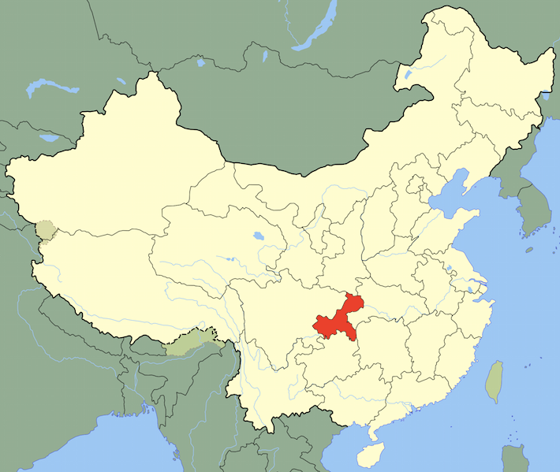
Introduction of CNU
School of Education is the largest school of CNU, with 125 teachers and over 3000 full-time students.
Founded in 1954, under the leadership of Chongqing Municipal Government of P. R. China.
School of Foreign Language has 129 faculty members, including 11 professors, 32 associate professors, 20 doctors (additional 8 PhD candidates), 25 master supervisors and 17 part-time master supervisors.
17 colleges, 109 master's programs,65 bachelor programs
Over 29,400 full-time students and 1700 teachers including more than 700 professors and associate professors.

Slide 5
CPD Units
2
Laboratory Infrastructure
Human Resources
Provided Services

Slide 6
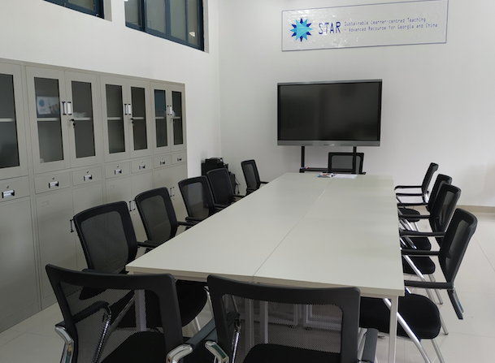
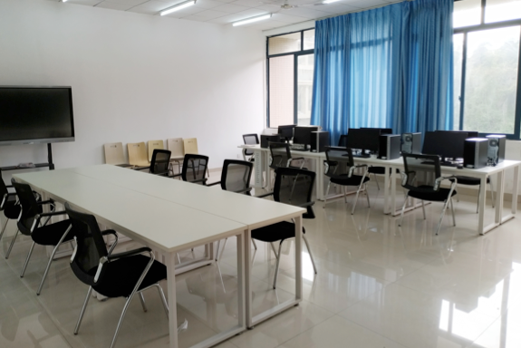
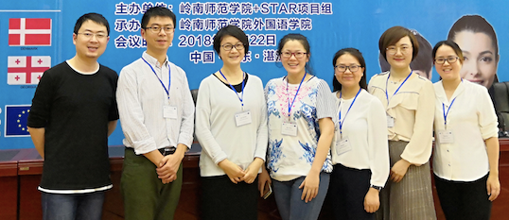
CPD Units: Erasmus+ STAR Project Lab
The CPD Units work closely with the Teaching and Learning Center of CNU, and obey the regulation system.
Provided Services
Conducting teacher training programs
Providing teaching consulting service
Conducting teaching and learning research
Developing excellent courses and resources
Human Resources
Laboratory Infrastructure
Coordinator/manager
Trained trainers
Educational technologists
60 square meters, with the required equipment, server, and network connection, etc.

Slide 7
Teacher Training Programs
3
Publicity meeting in the Faculty of Education (more than 120 teachers)
2 teacher trainings, 60 trained staffs
3 seminars, more than 58 staffs and postgraduate students

Slide 8
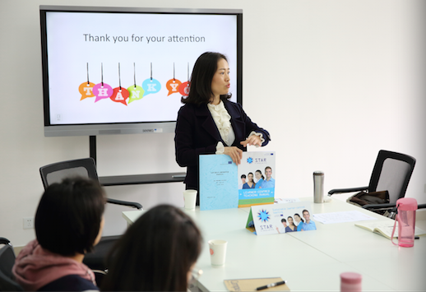
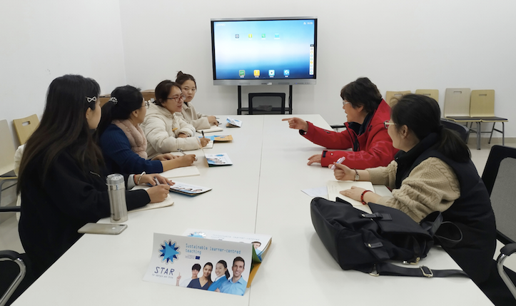
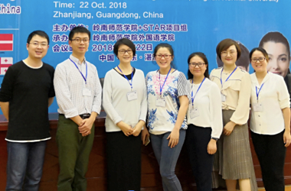
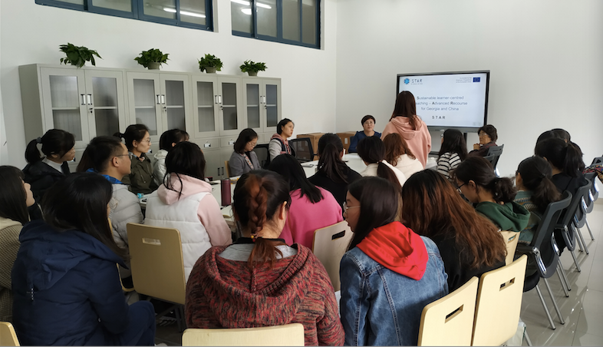
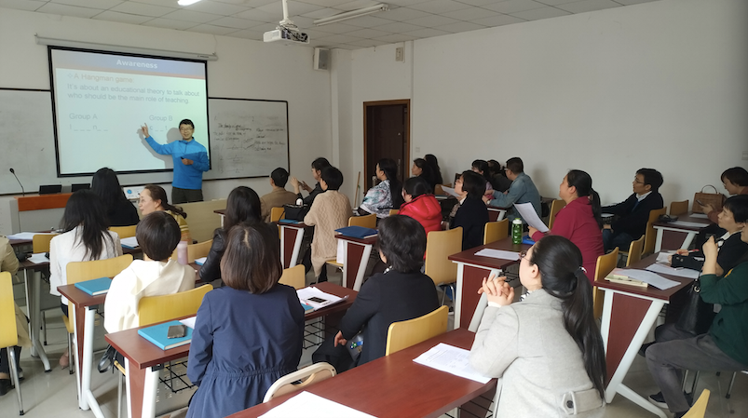
Teacher Training Programs

Slide 9
Application of LCT
4
Class Focusing on TBLT
LCT Employed in English for Teachers and Teaching (ETT)
Integrating LCT into the undergraduate courses (benefit more than 240 pre-service teachers)

Slide 10
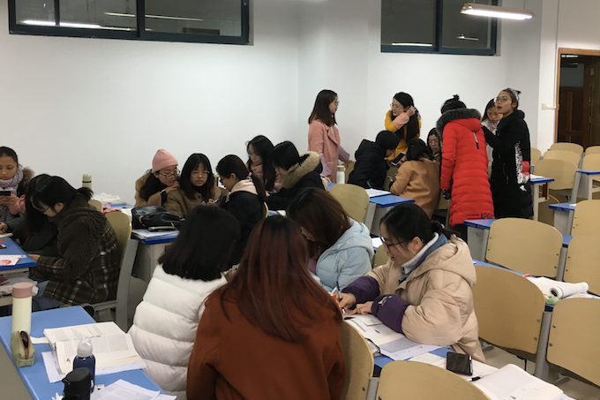
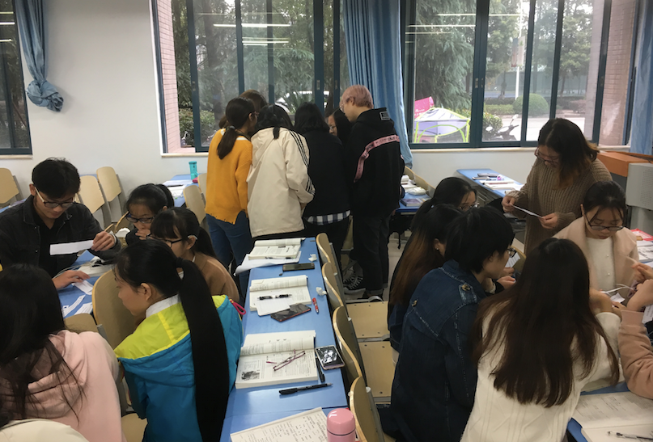
Brief Introduction to a Class Focusing on TBLT
Presentation and analysis ➔ Application ➔ Reflection
Group discussion

Slide 11
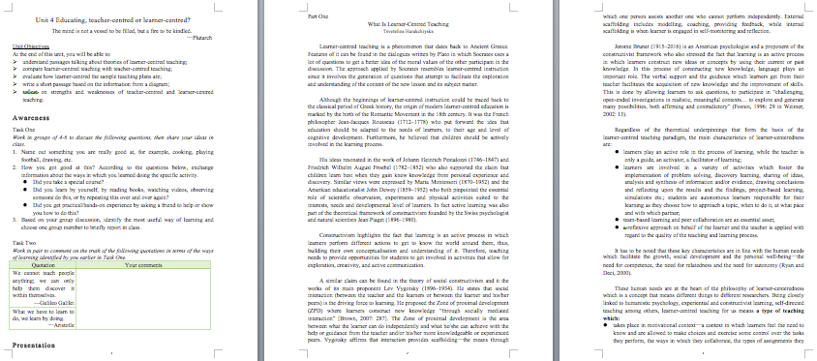
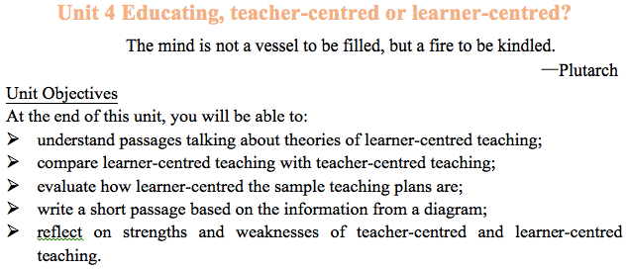
LCT Employed in ETT
A chapter named Educating, Teacher-centred or Learner-centred? has been put into the textbook of English for Teachers and Teaching (ETT)
Curriculum materials reform

Slide 12
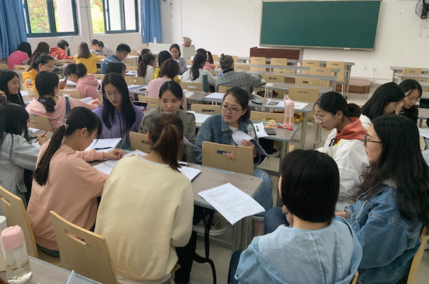
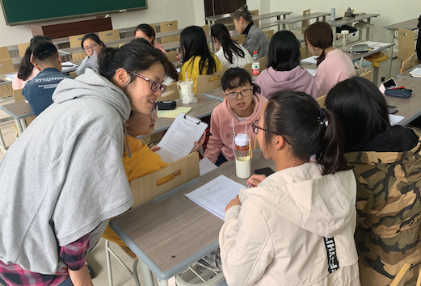
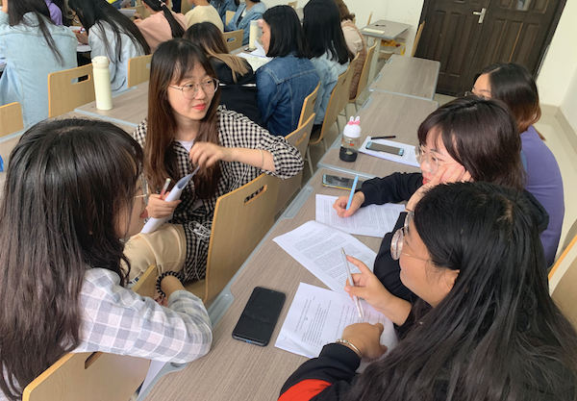
LCT Employed in ETT
Teacher assisting discussion
Group discussion

Slide 13
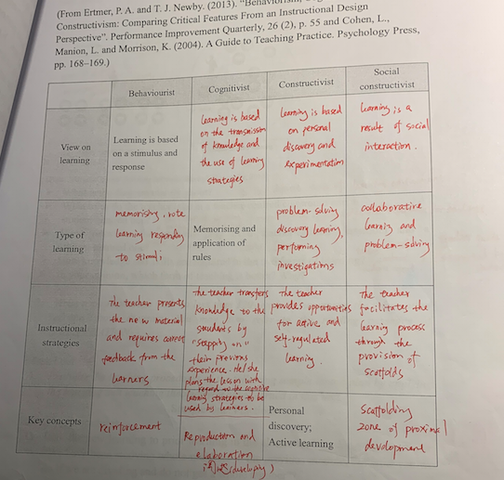
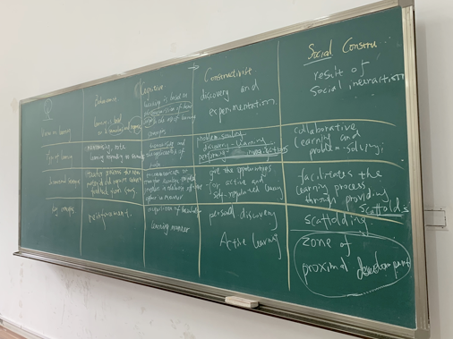
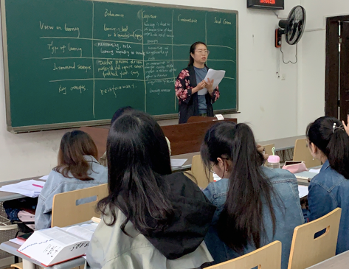
LCT Employed in ETT
Student giving oral introduction

Slide 14
S
T
A
R
Thank you for your attention!

