Slide 1
Learner-centred Teaching
--from a concept to changes
Haiyan Feng
LISE
Notes:
更多模板请关注：https://haosc.taobao.com

Slide 3
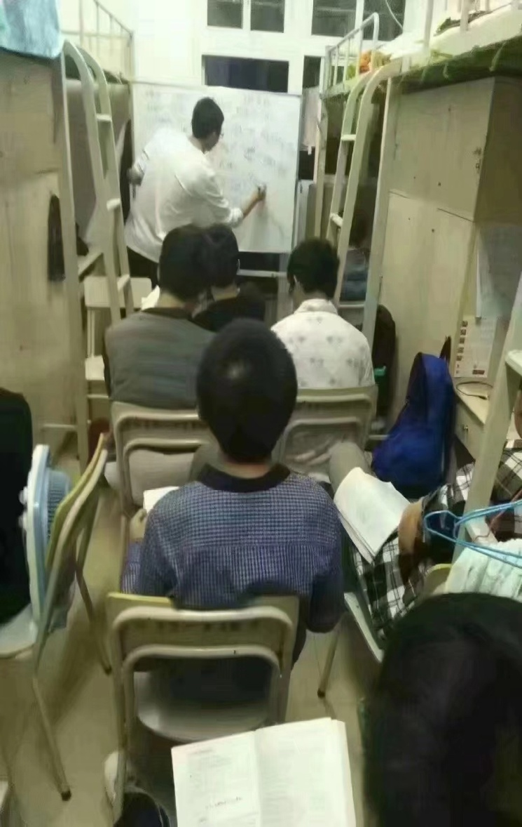
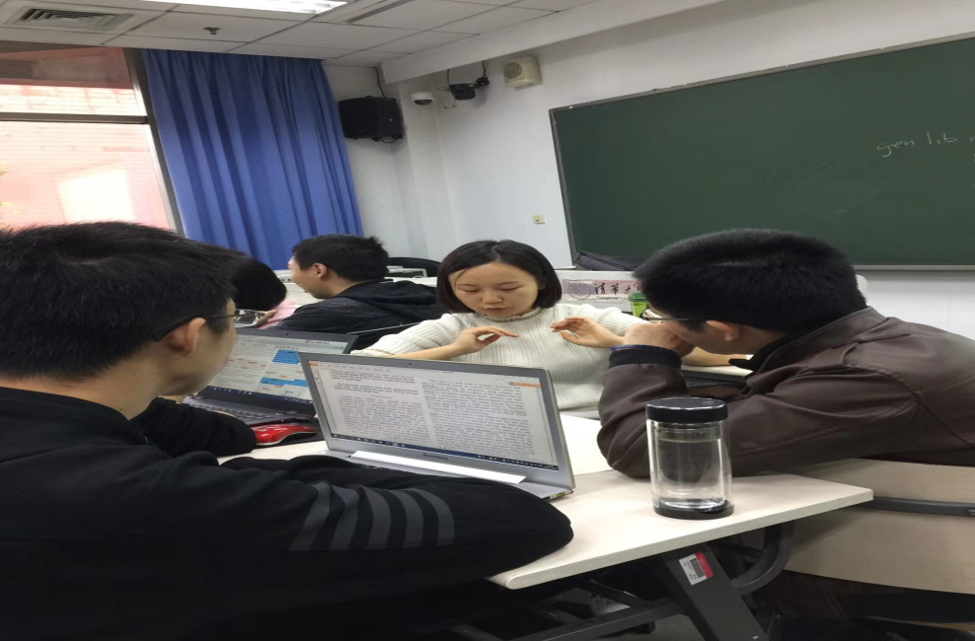

Slide 4
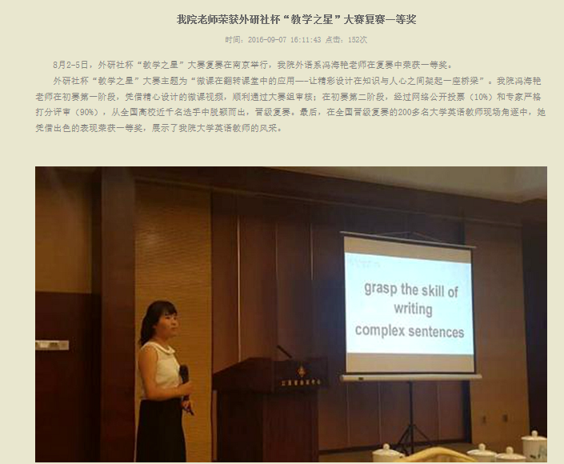

Slide 5
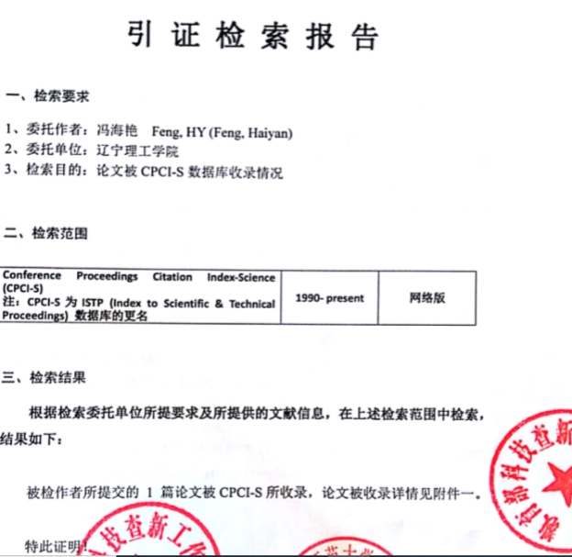
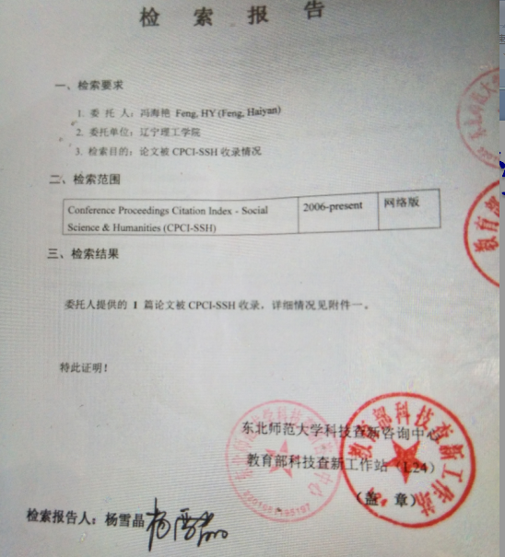

Slide 8
Virtual English Learning Community under the Mobile Internet Environment

Slide 9
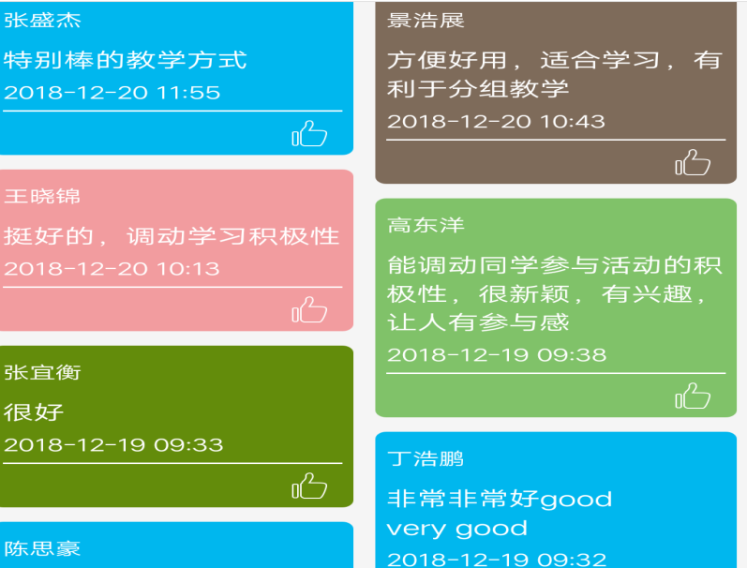
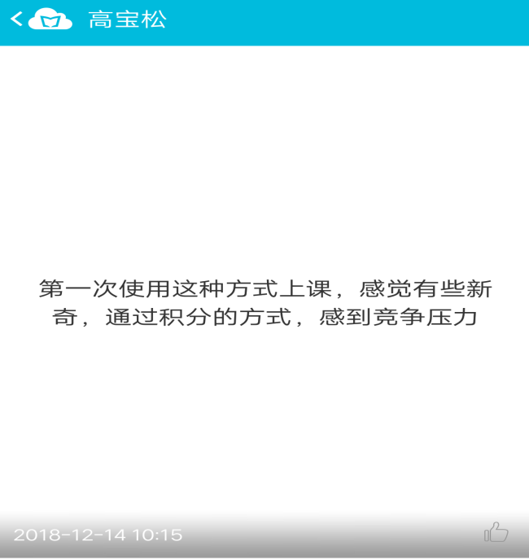

Slide 10
Year | The number of participants | The number of the awarded
2018年 | 472 | 102
2017年 | 422 | 82
2016年 | 323 | 37

Slide 11
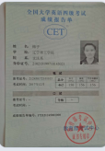
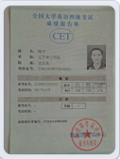

Slide 12
Thank you
Have a nice day

