Slide 1
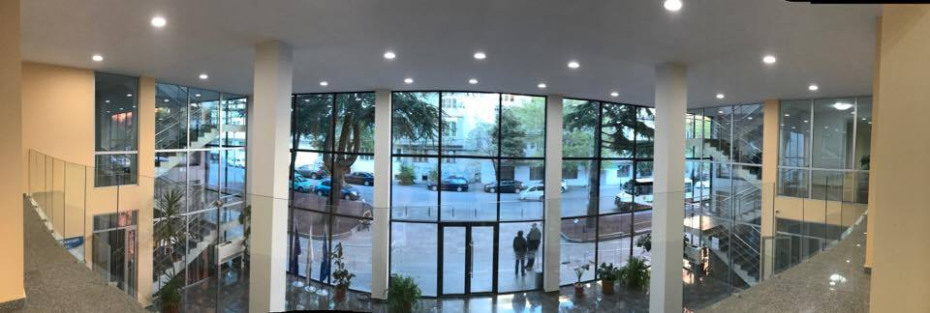
Sulkhan-Saba Orbeliani University
Center for Continuous Professional Development
LEARNER-CENTRED TEACHING IMPLEMENTATION:
Challenges & Opportunities
(Experience of SABAUNI )
Dr. Ekaterine Natsvlishvili
Professor, CPD Trainer
Tbilisi,
June 4, 2019

Slide 2
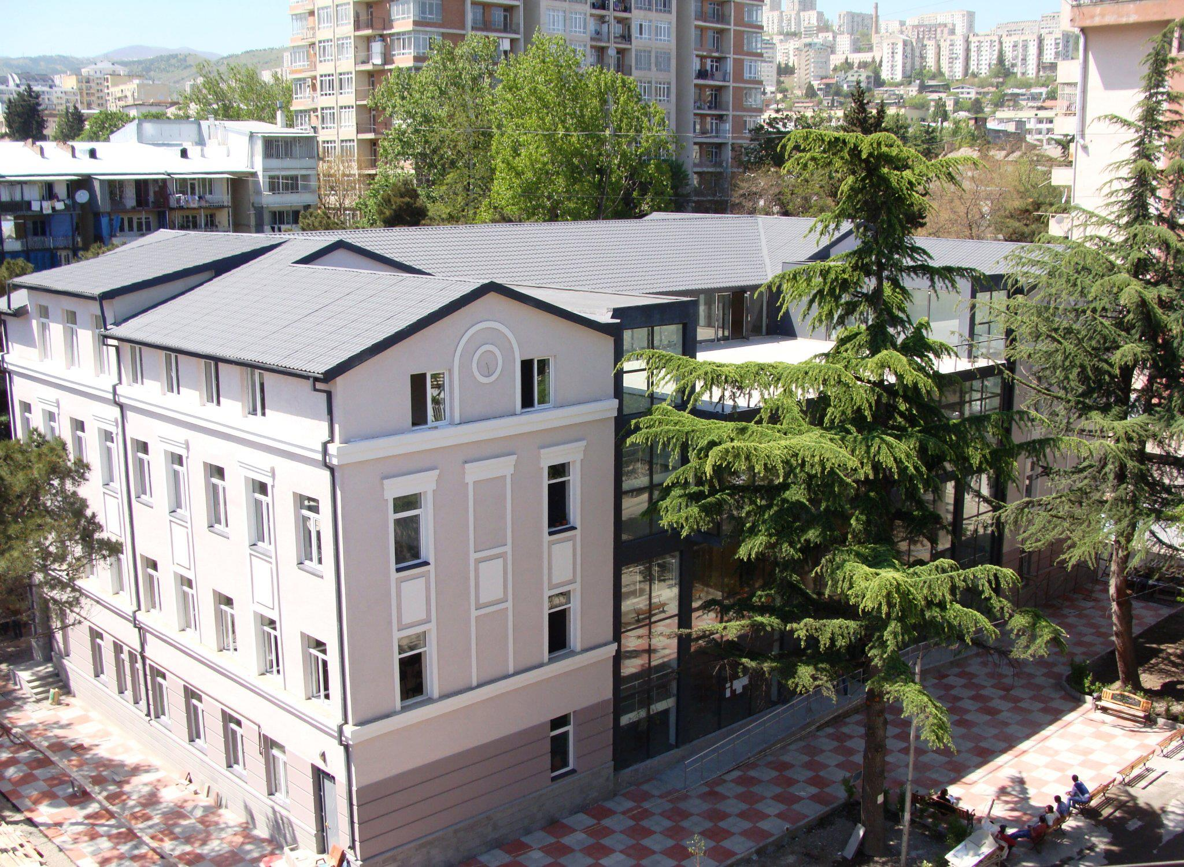
Sulkhan-Saba Orbeliani University (SABAUNI)
A private HEI founded in 2002
A member of the Network of Eastern European Universities , FUCE, IFCU
From 2015-2016 participates in ERASMUS+ programs
Offers 6 undergraduate and 3 postgraduate programs (all programs are accredited by NCEQE)
Are employed more than 150 academic staff (affiliated, as well as visiting professors) and 52 administrative staff
Established 5 Research Institutes, and
Center for Continuous Professional Development
Sulkhan-Saba Orbeliani University

Slide 3
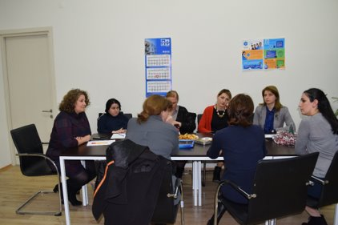
SABAUNI as a Partner University of STAR Project
SABAUNI is involved in the project STAR as a Partner University.
SABAUNI’s role within the project is to:
be involved in the process of developing the student-oriented teaching methods;
implement learner-centred teaching methods throughout the university;
take part in the process of developing the manual;
contribute to manual translation to Georgian;
take part in developing a virtual academic network for improving methodology;
assist in the dissemination of the project results;
support all the work packages;
recruit local staff for training;
ensure the sustainability of the project beyond the project lifecycle.
Sulkhan-Saba Orbeliani University

Slide 4
ACTIVITIES WERE DONE WITHIN THE STAR PROJECT
Organize training, workshops for the representatives of other HEIs and society at large, to disseminate the project results as well as raise awareness about learner-centered approaches and implementation of innovative teaching strategies.
Organize training for the CPD trainers, teachers, and staff involved in developing the study process, administrative staff, on learner-centred teaching, evaluation and assessment methods.
Contribute to the development of a manual and its translation to Georgian, as well as support the activities for the manual’s dissemination
Establishment of the Centre for Continuous Professional Development (CPD) and take part in developing a virtual academic network for improving an innovative pedagogical methodology.
To study, combine and share the interesting practices in Learner-centred teaching and implementing innovative teaching methods, as well as the best international experience in CPD Units development and management.
Take part in kick-off meetings, cooperation with Project Partners for developing partnership and assisting to reach the project´s aims.
Sulkhan-Saba Orbeliani University

Slide 5
List of the SABAUNI’s Activities done within the STAR Project
CPD establishment and approval by the rector’s order N101-17
LAB equipped with the techniques purchased within the project STAR
CPD and project presentation with the university staff (25/04/2018; 21/11/2018)
http://sabauni.edu.ge/en/student-life/sabauni-news/314-cpd-center
Sabauni staff were trained by project trainers at University of Georgia (16-18/10/2018)
http://sabauni.edu.ge/en/student-life/sabauni-news/317-training-of-trainees-and-star-project-meeting-in-tbilisi-zhanjiang
http://sabauni.edu.ge/en/student-life/sabauni-news/319-star-project-interim-report-and-presentation-of-cpd-unit
Meetings with trained staff and preparation of Training for SABAUNI staff
http://sabauni.edu.ge/en/student-life/sabauni-news/337-planning-of-the-activities-of-cpd-unit
Training for academic staff (16/02/2019 - (statistics – 45 academic staff were trained)
http://sabauni.edu.ge/en/student-life/sabauni-news/350-%E2%80%9Clearner-centred-teaching%E2%80%9D-training-for-academic-staff
Training on modern teaching methods in languages
Training for academic staff involved in implementation of Programs in theology conducted by QA office
http://sabauni.edu.ge/en/student-life/sabauni-news/352-a-workshop-for-academic-staff-of-faculty-of-theology
Training for academic staff of Samtskhe-Javakheti State University (Akhaltsikhe) (50 academic staff)
http://tv9news.ge/ka/akhali-ambebi/ganathleba/article/12277--rasmus-proeqtis-fargelbshi-samckhe-javakhethis-sakhelmtsifo-universitets-saba-uni-estumra
https://www.facebook.com/permalink.php?story_fbid=1229412143873939&id=357629064385589\
Training for academic staff from different universities (Public training, open call)
http://sabauni.edu.ge/en/student-life/sabauni-news/361-leaner-centered-teaching-training
Demo video on TBL (for the platform) - https://www.youtube.com/watch?v=nWRDWQOEcqI
Short interview with students about the modern teaching methods -
Short video from class (faculty of Law) -
Translated manual was uploaded on the web page -
Sulkhan-Saba Orbeliani University

Slide 6
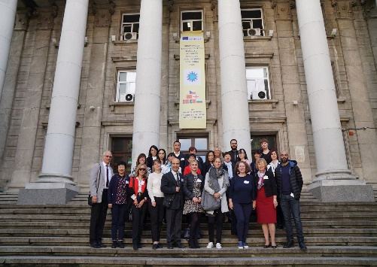
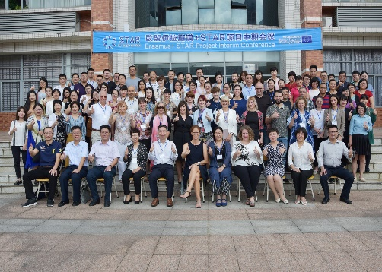
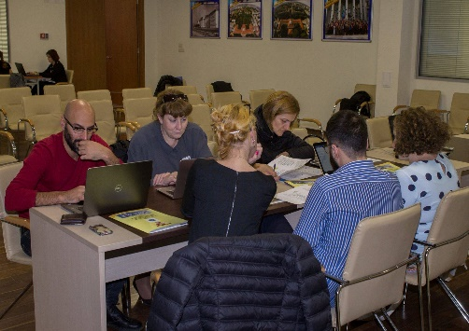
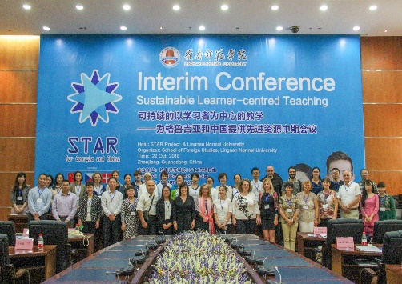
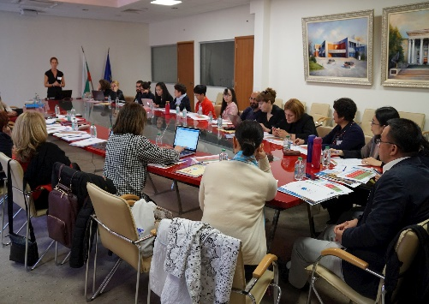
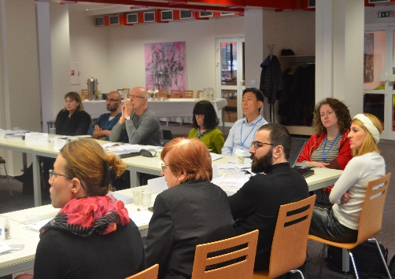
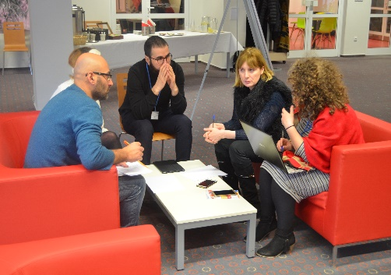
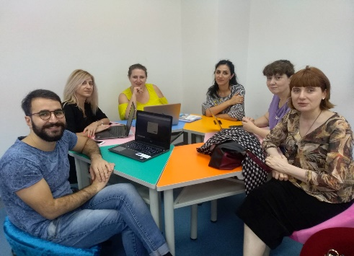
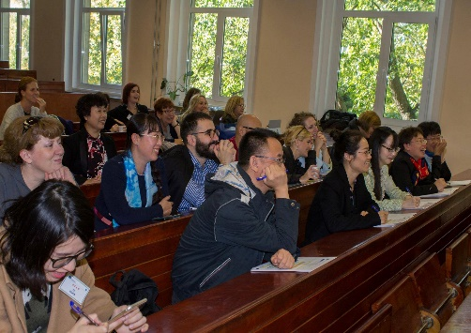
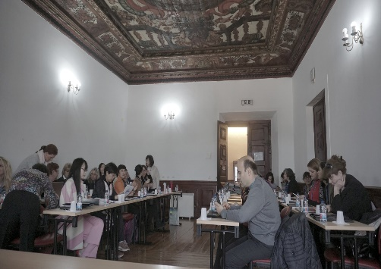
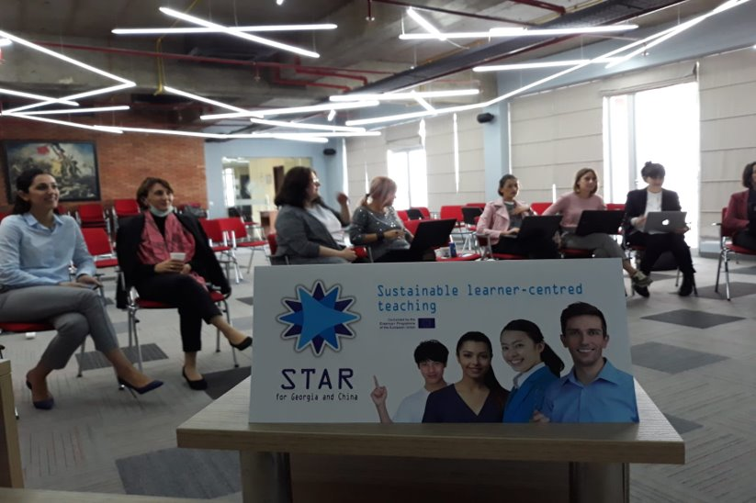
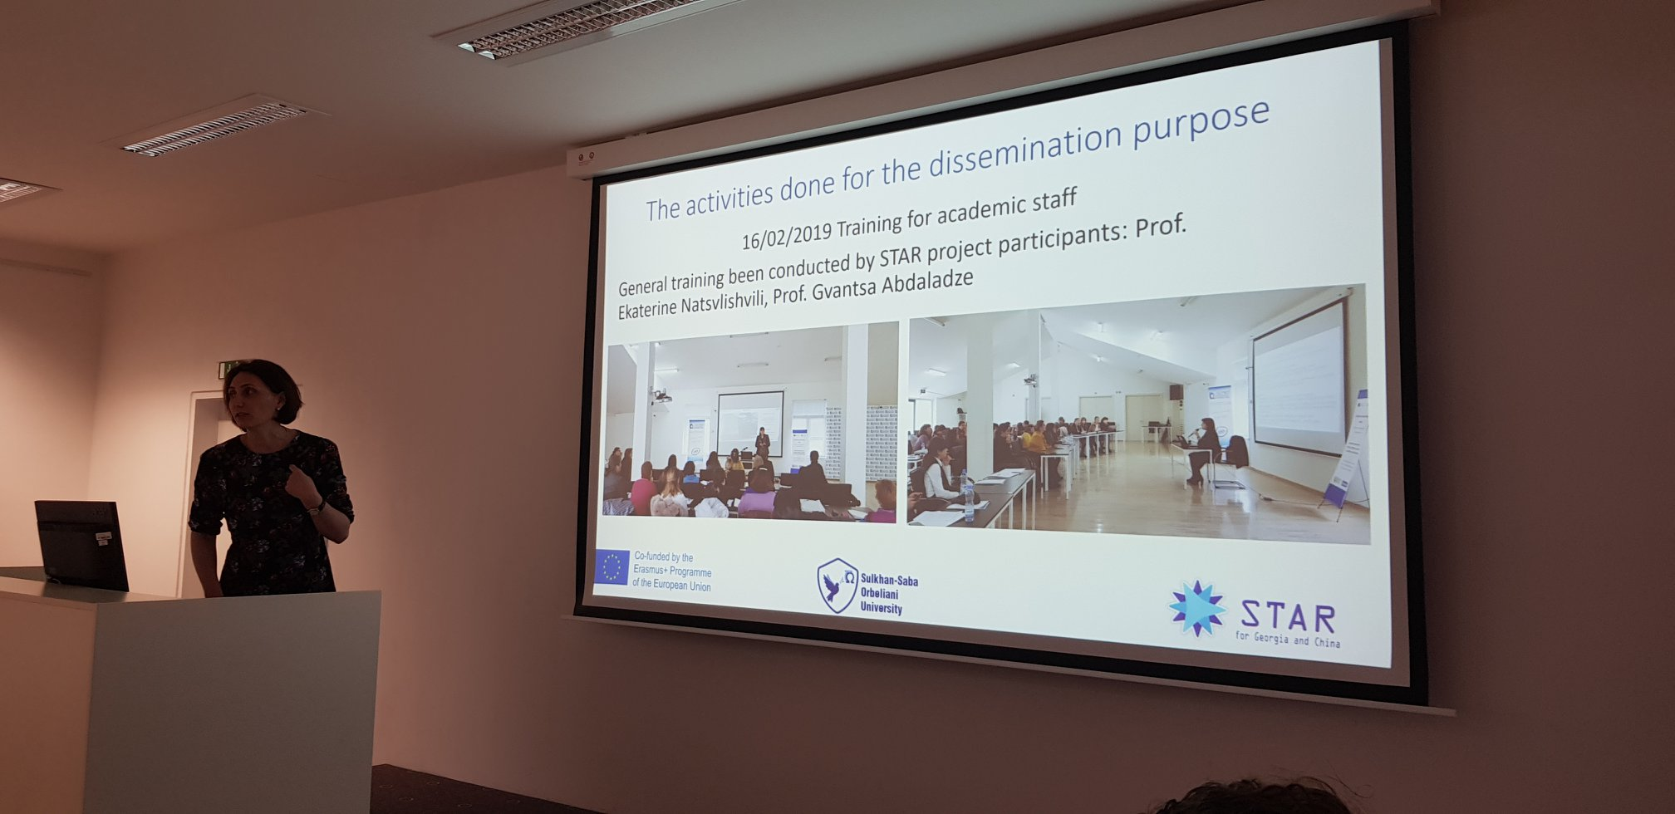
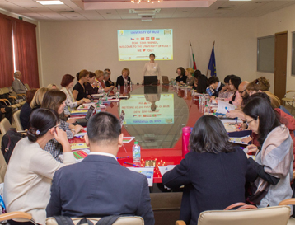
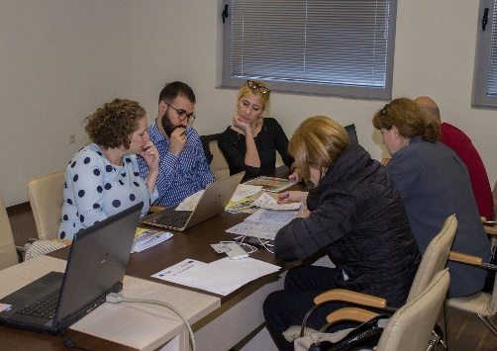
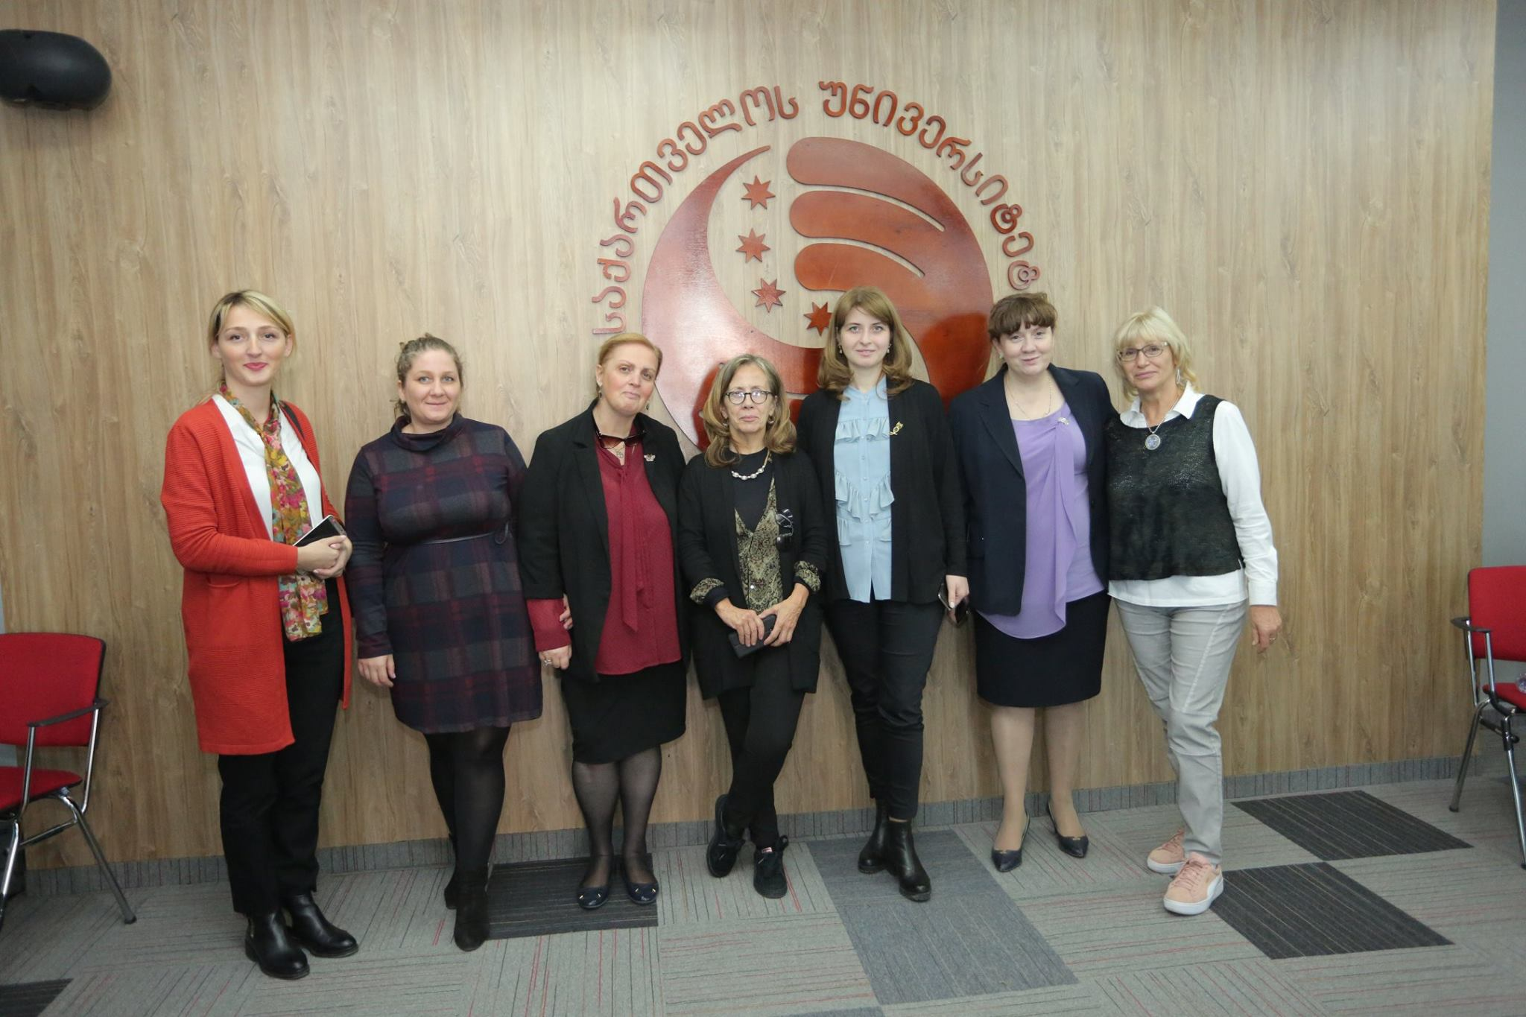
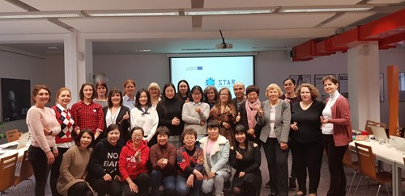
1. Participation in Project Partners Meetings and Conferences
Project's meeting in Brno
February, 2017
Project's meeting in Ruse
October, 2017
Project's meeting in Coimbra
March, 2018
Project's meeting in Tbilisi
October, 2018
Project's meeting in Zhanjiang
October, 2018
Project's meeting in Brno 2
February, 2019
Sulkhan-Saba Orbeliani University

Slide 7
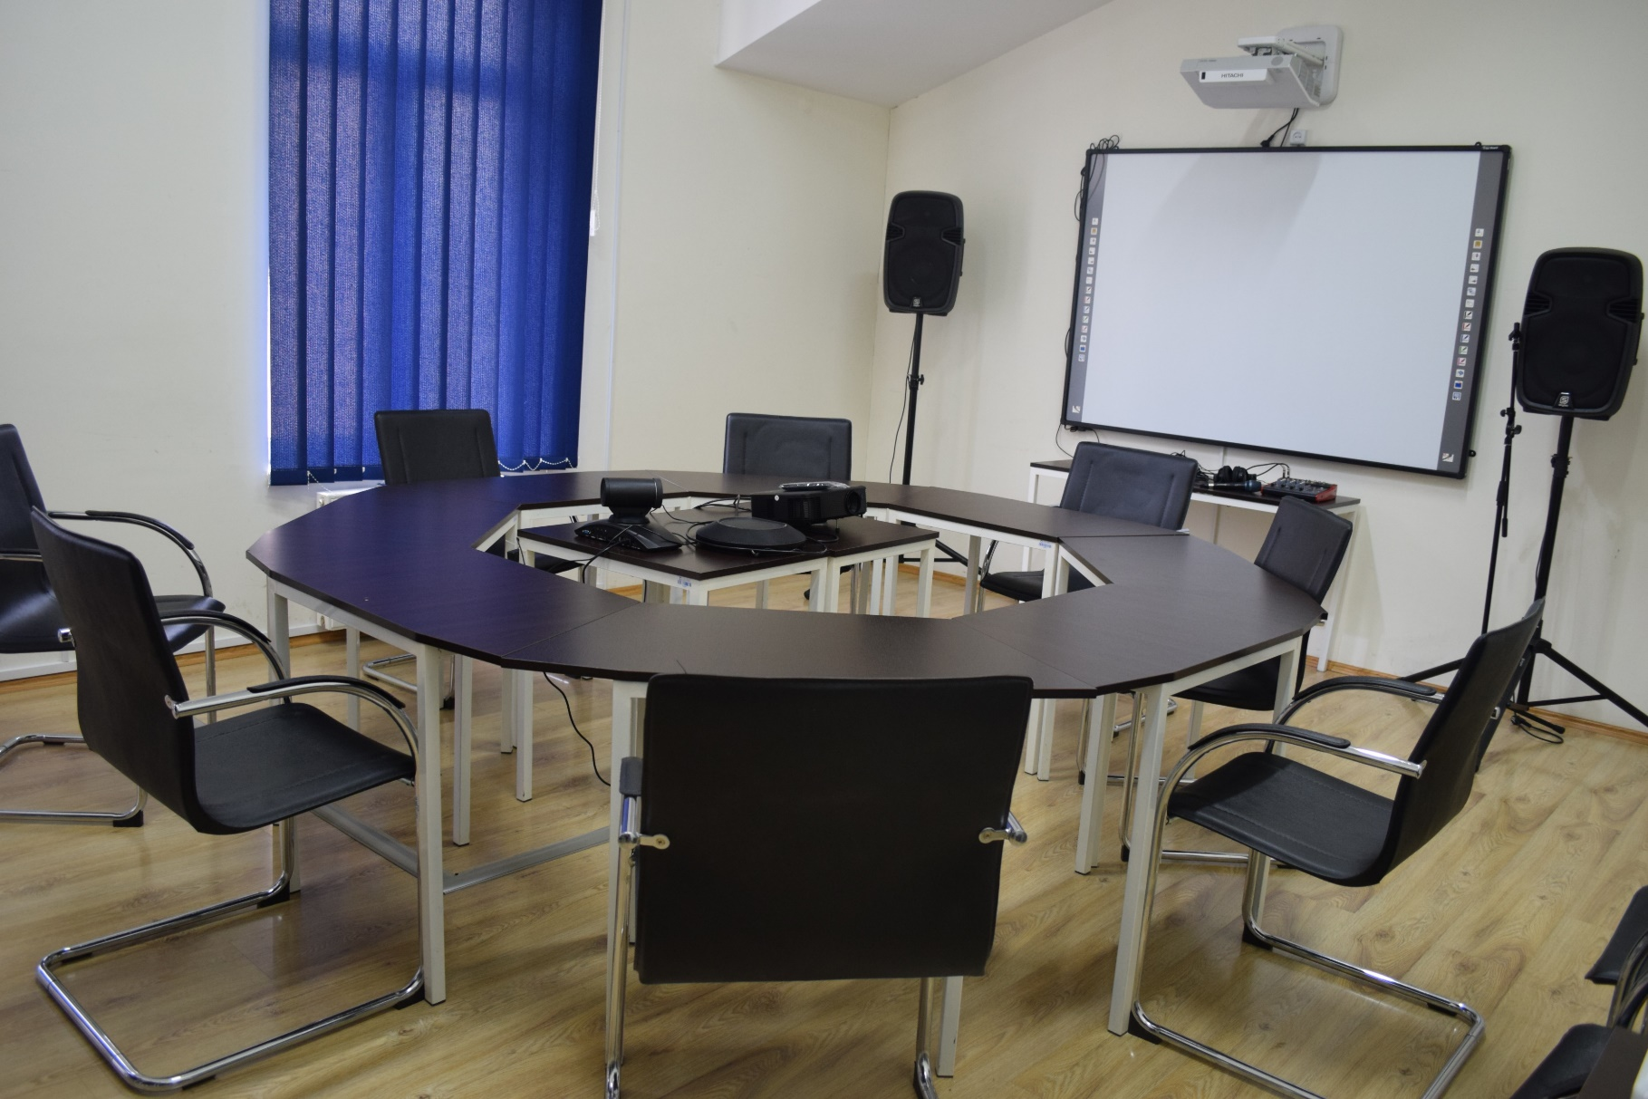
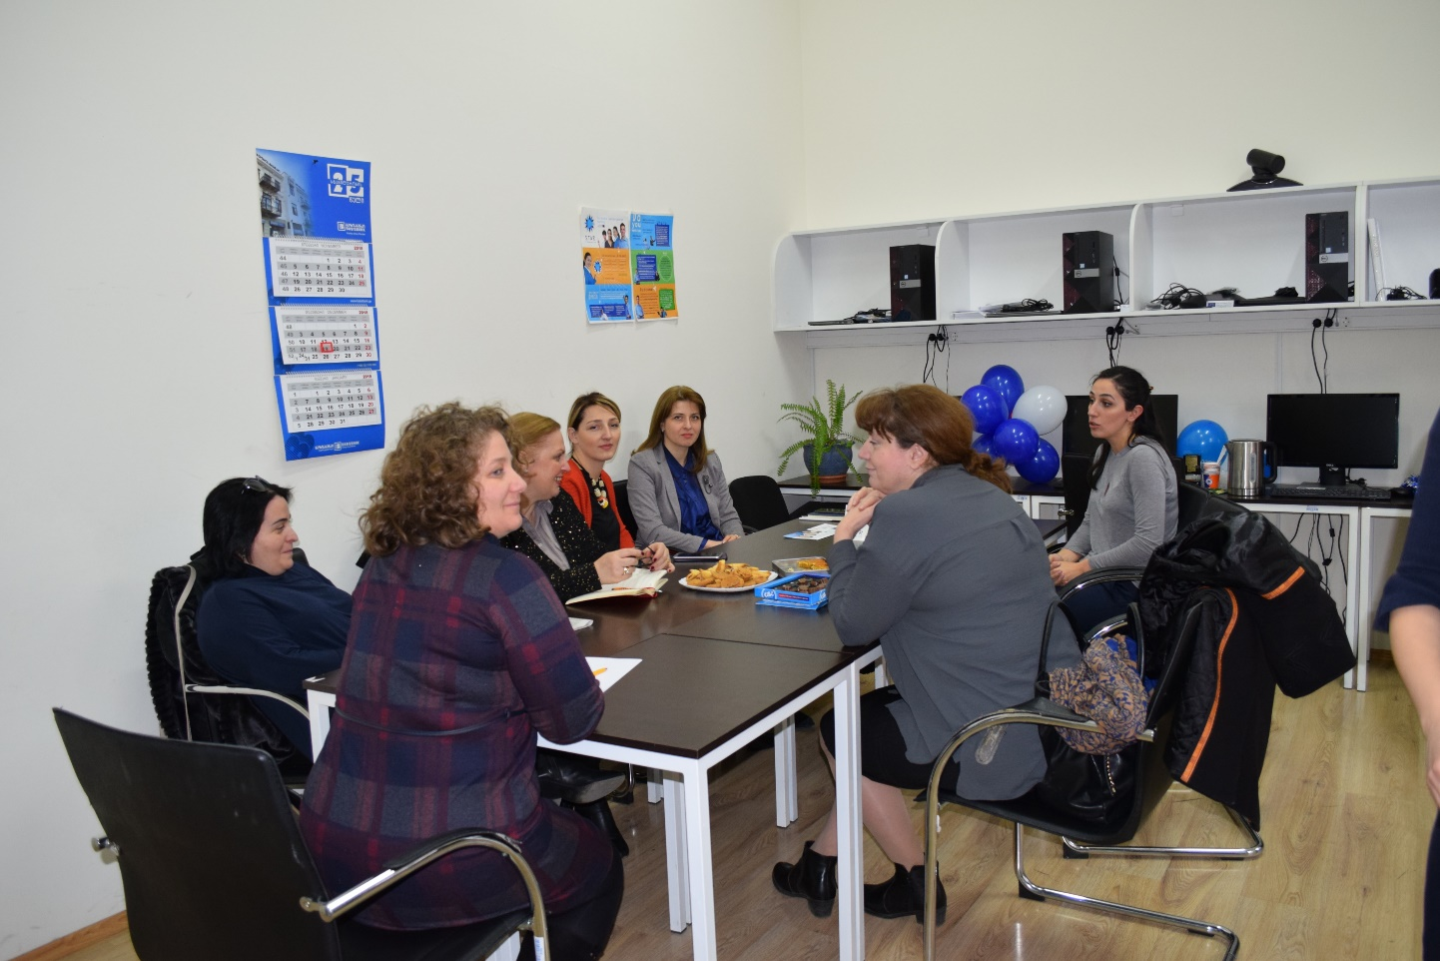
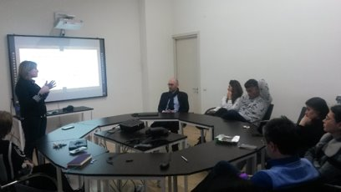
2. Center for Continuous Professional Development (CPD)
The CPD Unit was established in 2017
CPD is subordinated to the International Relations Office (in the future - to HR office)
There is a separate room for the center (equipped within the project), as well as the page on the University website - ( http://sabauni.edu.ge/en/about-us/cpd )
The aim of the CPD:
To support the improvement of Quality of the education and its approaching to the Modern Standards through the implementation/dissemination of the LCT
To determine the needs for professional development of academic and administrative staff of the university and its support
Main objectives:
To organize trainings/workshops/seminars, to provide information about the trainings held in the other universities for academic and administrative staff of the university
To develop training materials and disseminate them through the stakeholders.
The structure of the CPD
The coordinator of the Center
Trainers
Head of Quality Assurance Office
Deans of the faculties and Chairpersons of the educational programs
How do we work:
Needs Analysis via the survey (questionnaires) conducted by the CPD in cooperation with QA office and the faculties at the beginning of the semester;
Organization of the training and workshops
Feedbacks
Sulkhan-Saba Orbeliani University

Slide 8
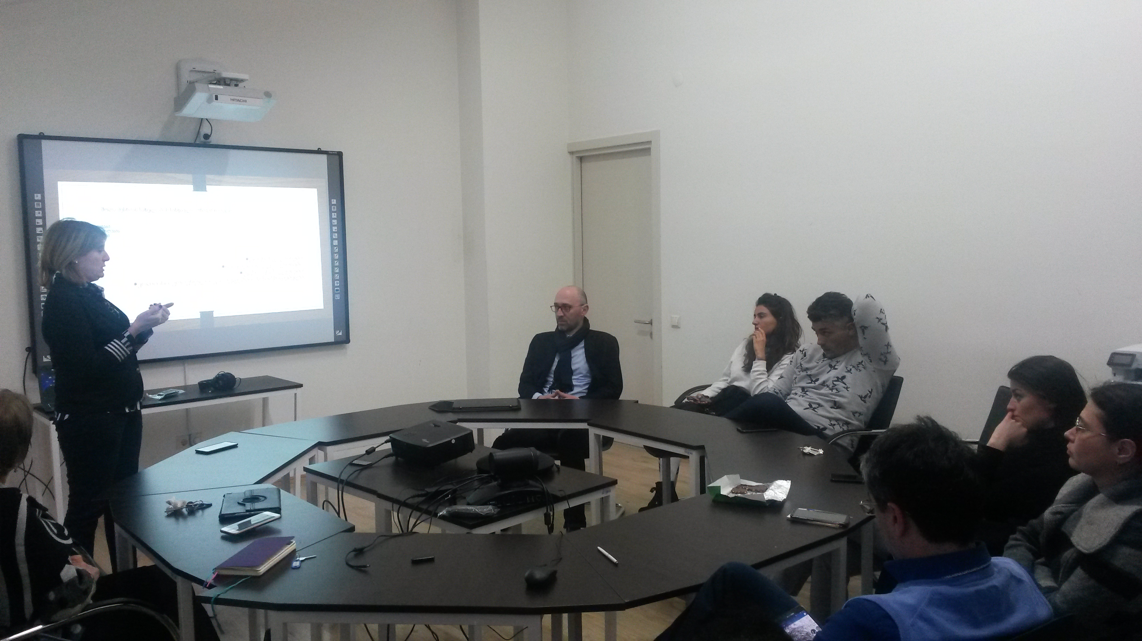
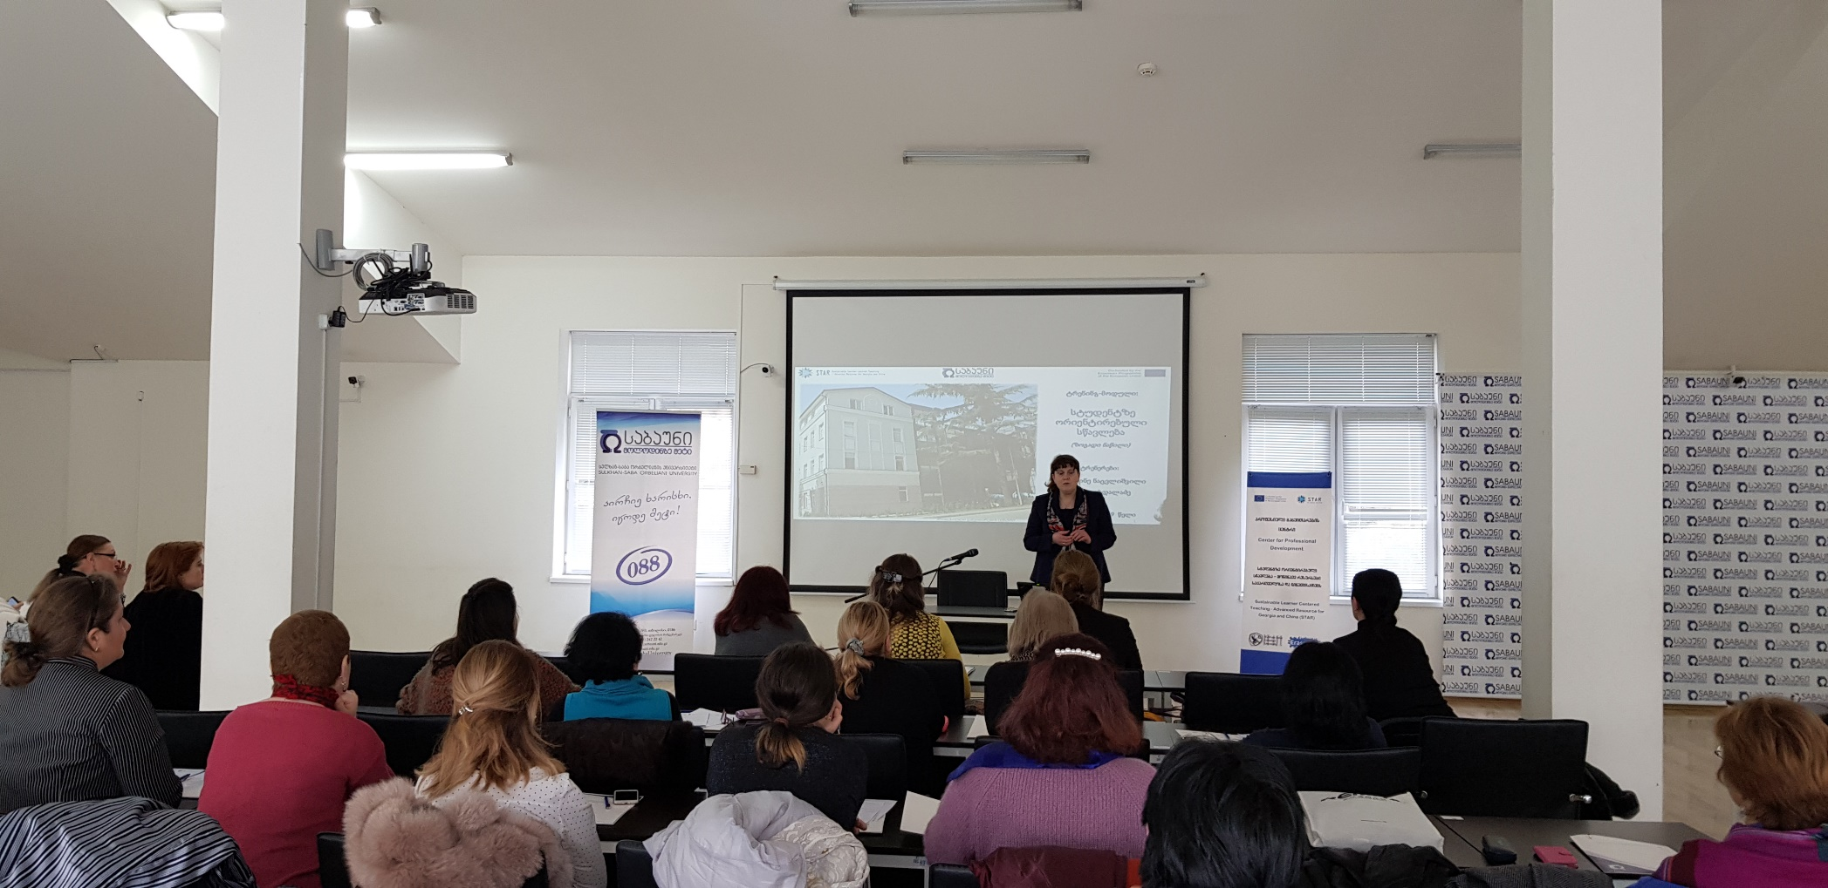
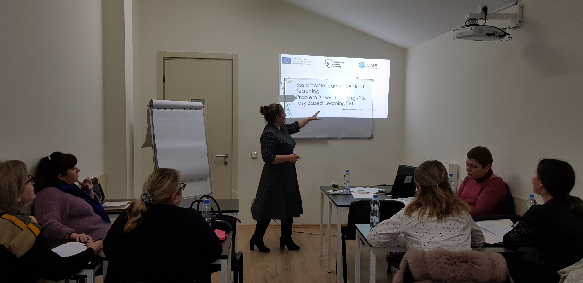
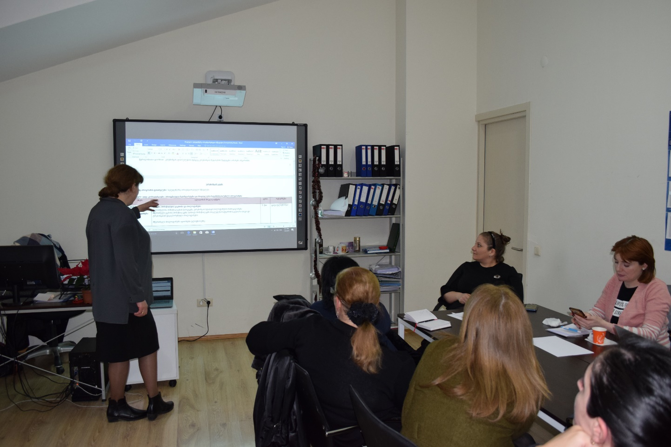
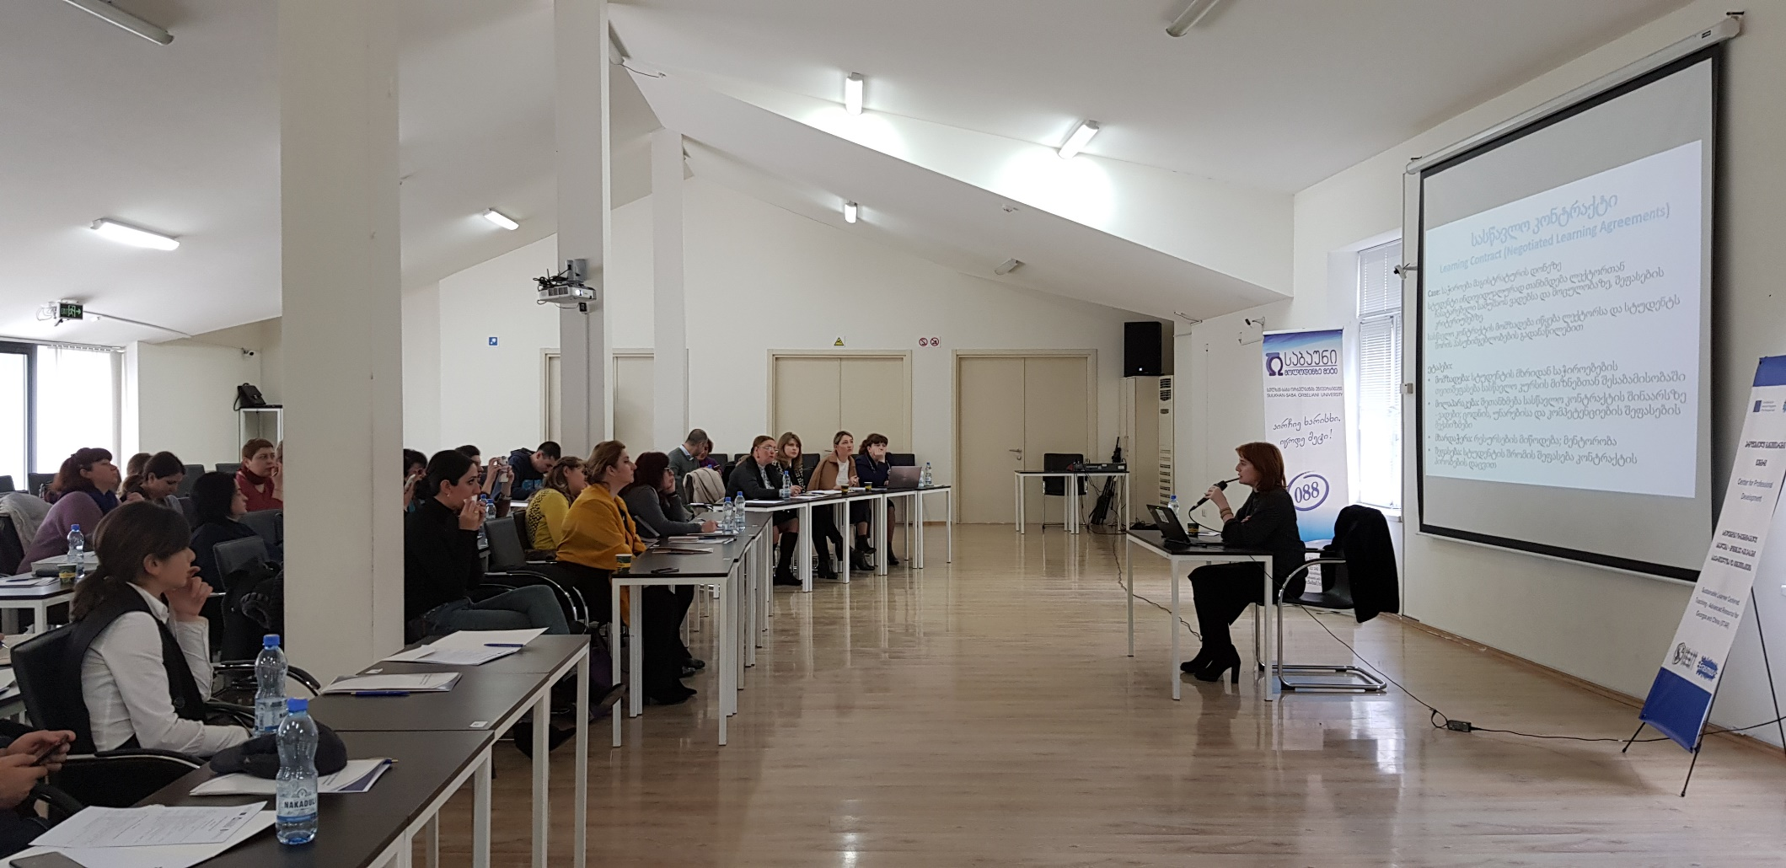
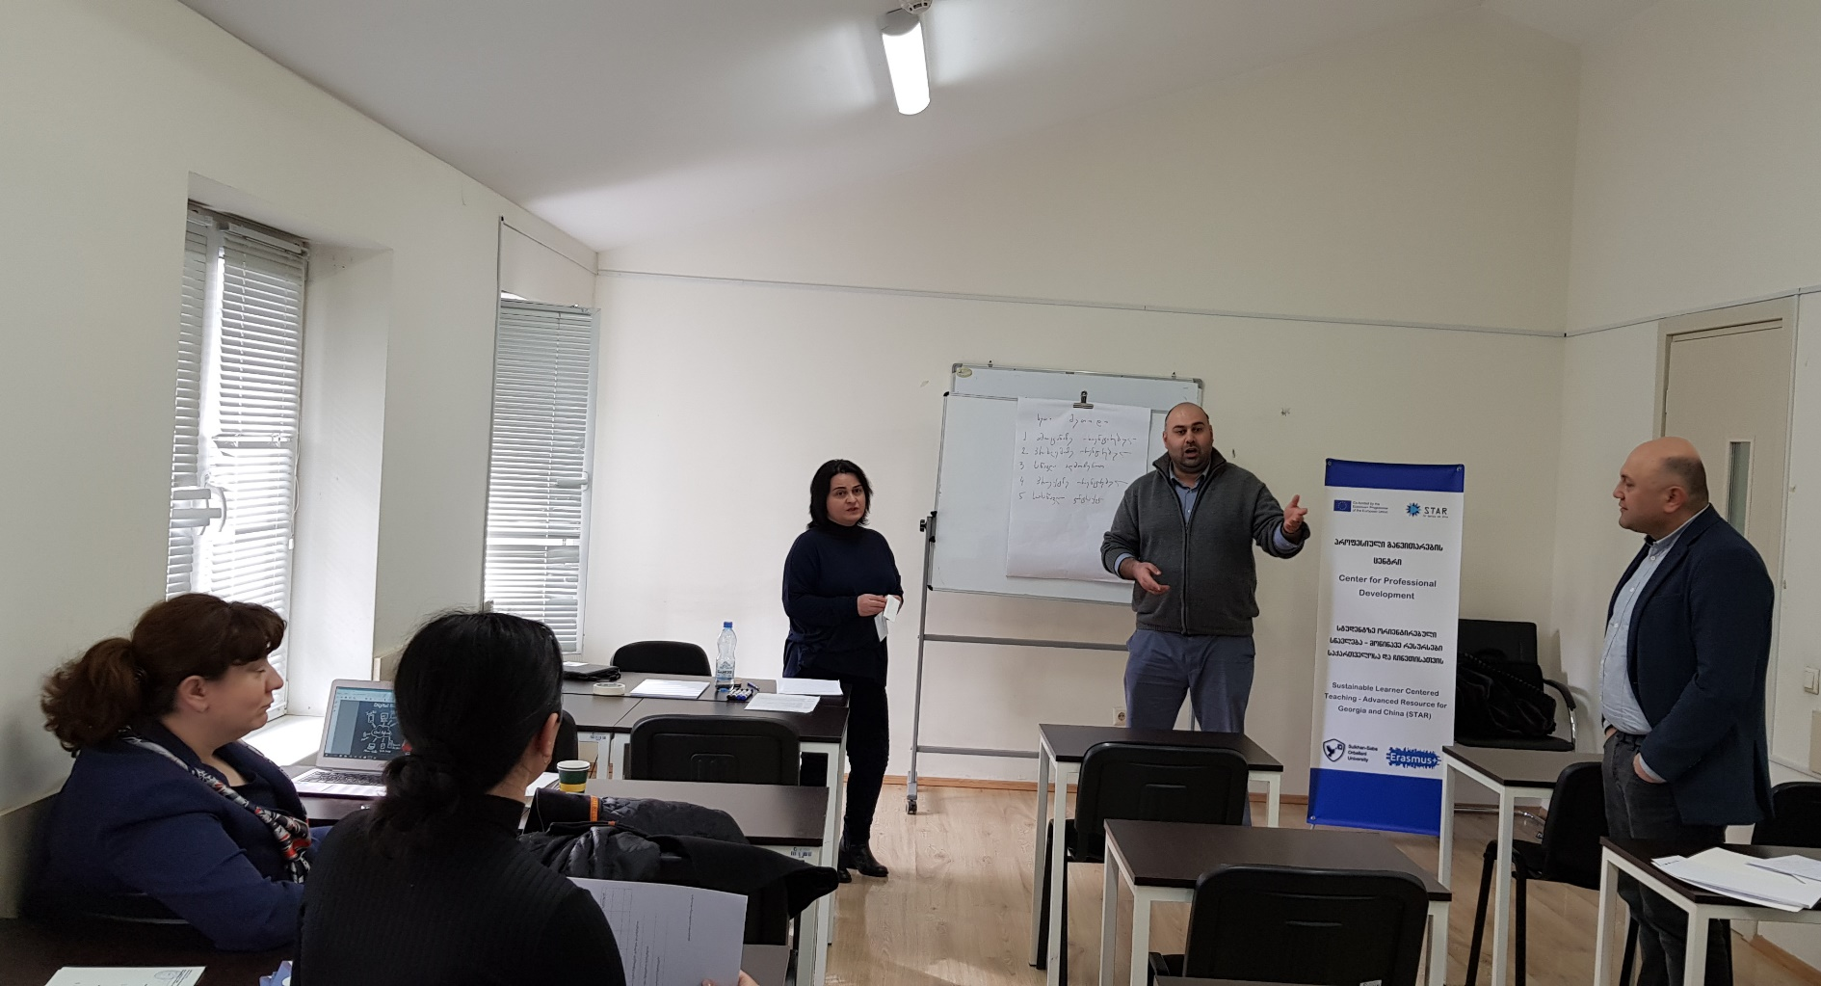
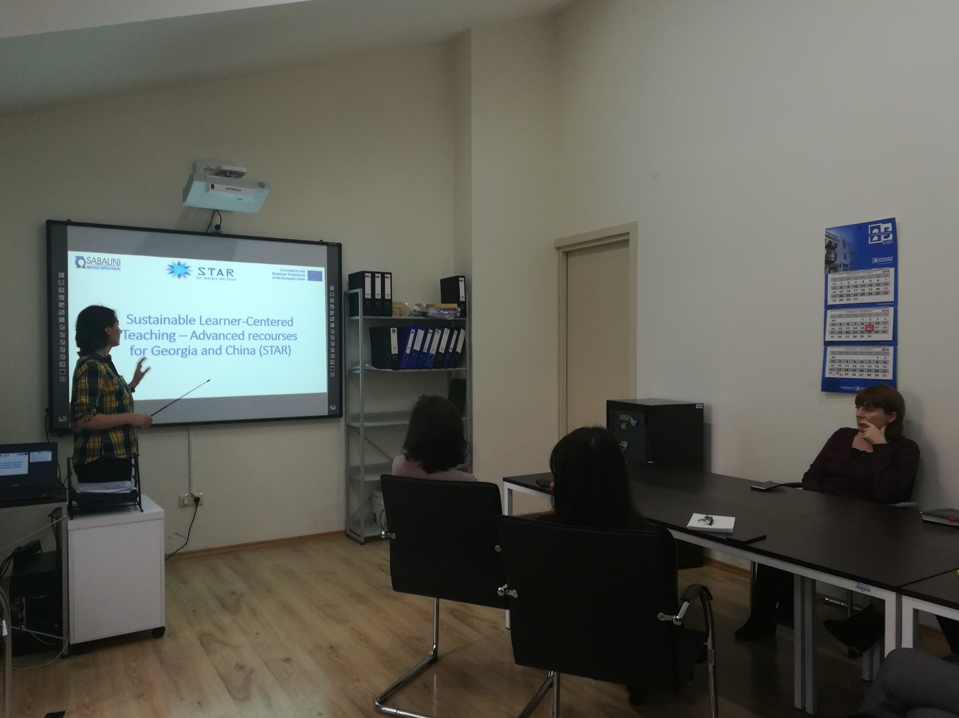
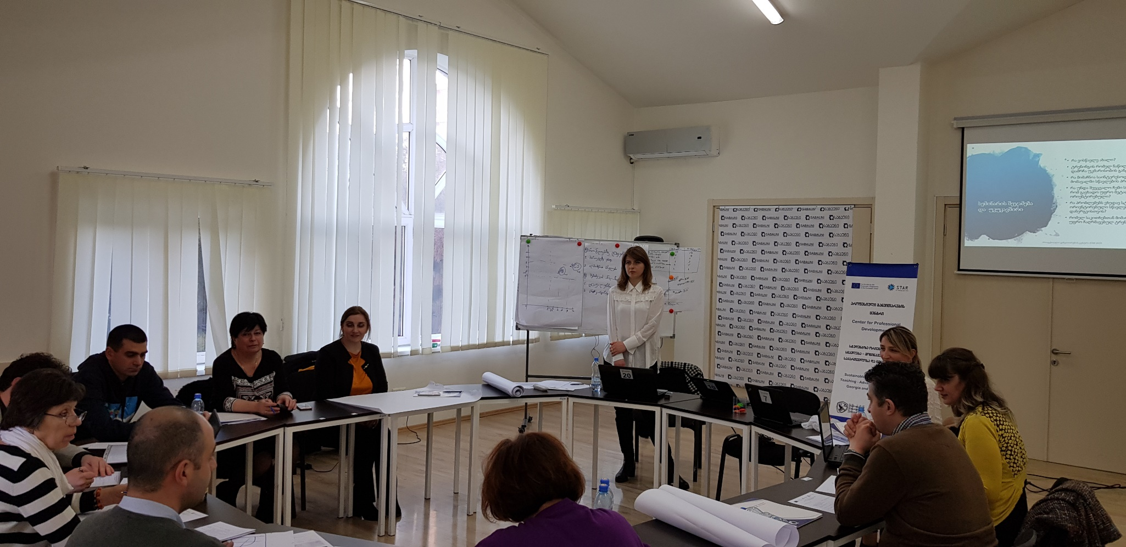
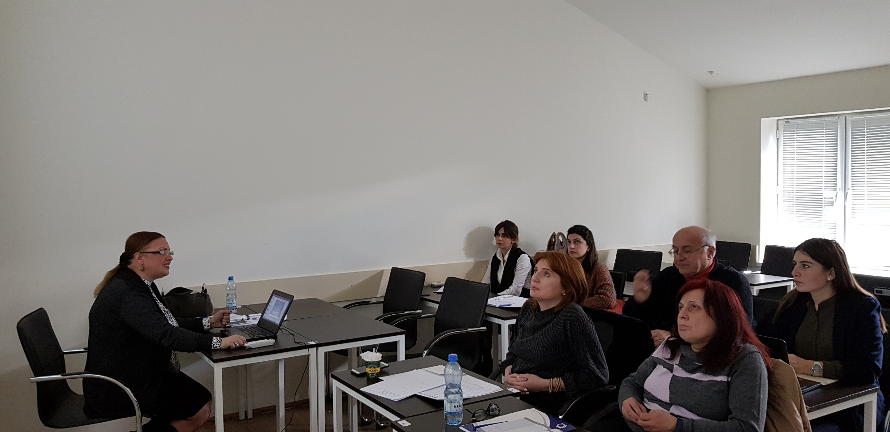
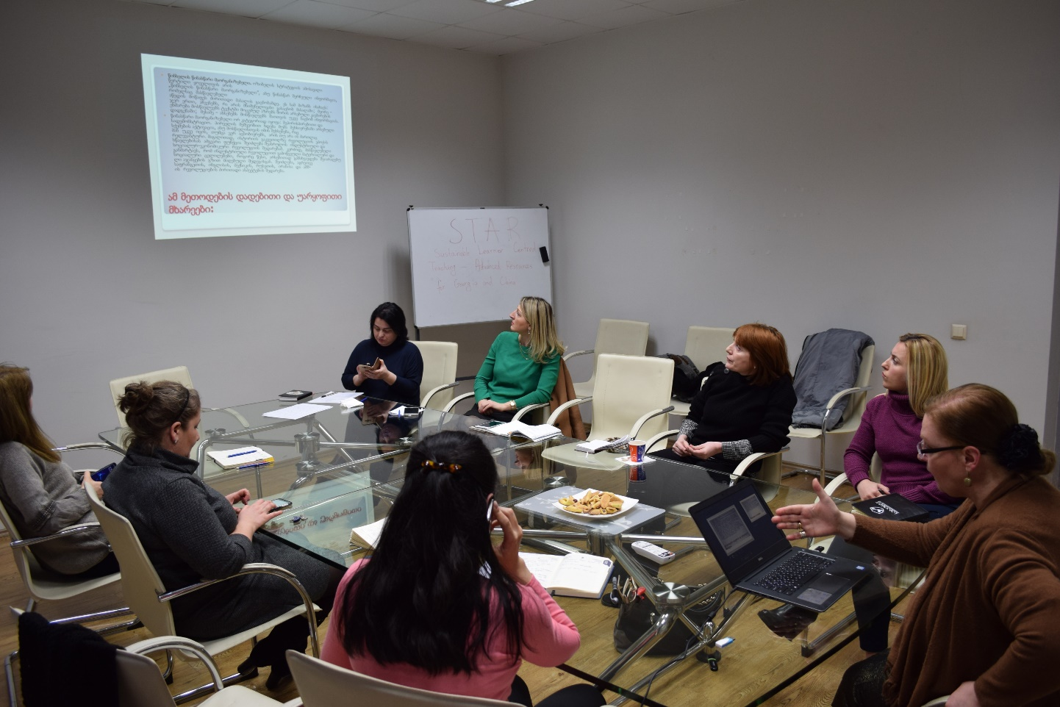
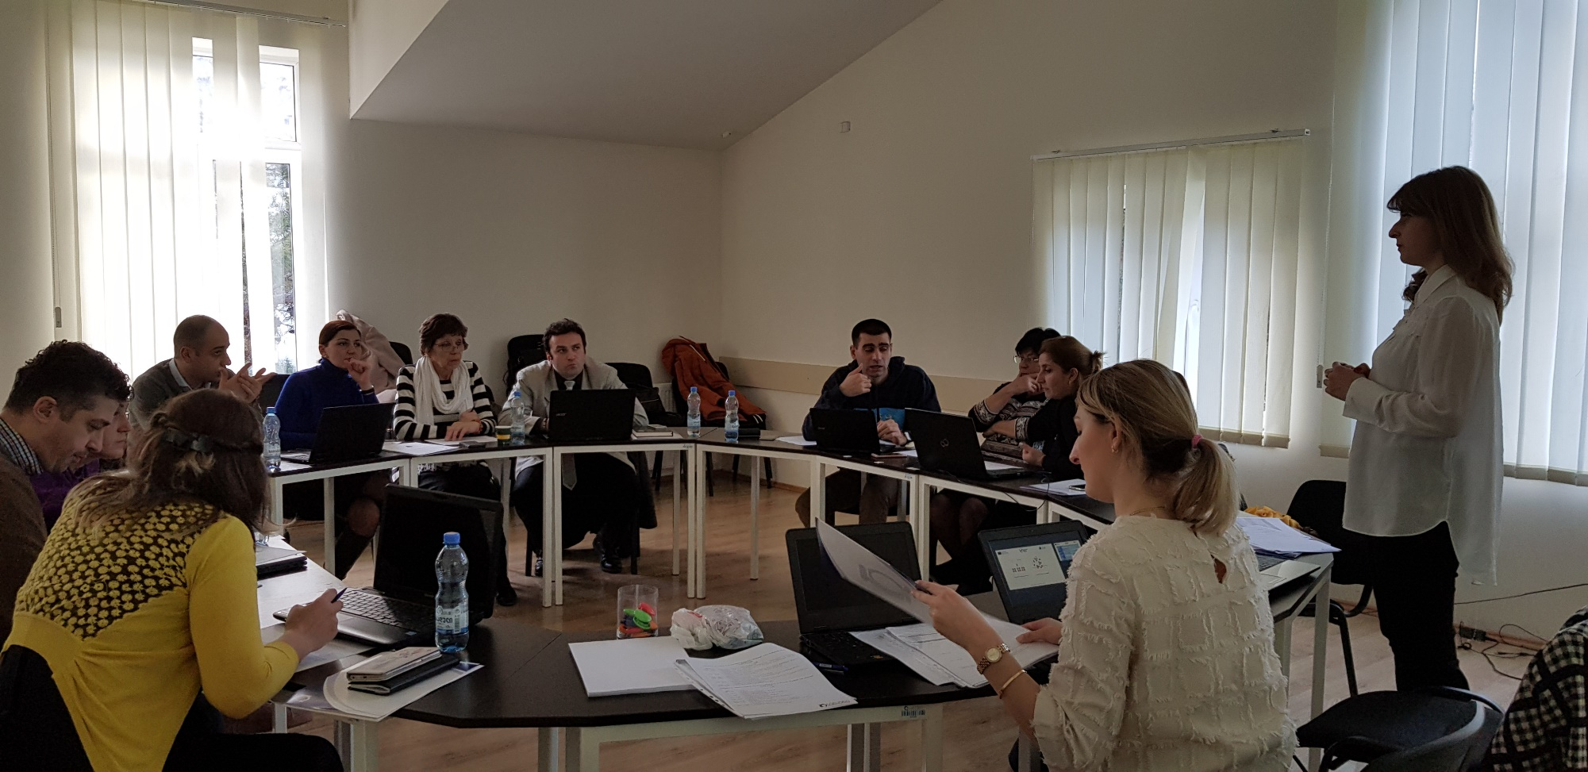
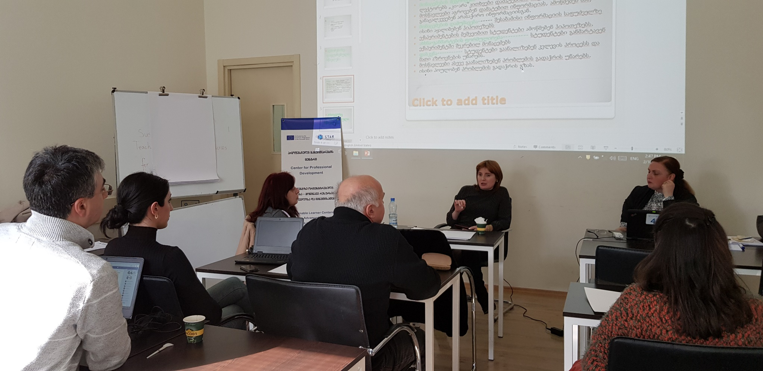
3. CPD Activities toward the Implementation of LCT Approach in SABAUNI
Meetings
arranged with trained academic staff for sharing opinions and planning the training for the rest of academic staff
General training
for SABAUNI Academic Staff on the introduction and promotion of a learner-centred paradigm in the array of innovative teaching approaches and strategies
Workshops for Academic Staff of:
faculty Humanities and Social Sciences on: Project based learning and Discovery learning
faculty of Business and Tourism on: PBL, Project based learning and Discovery learning
Faculty of Law on: PBL, TBL, Project based, discovery learning
Language Center professors on: TBL, PBL
Totally more than 45 affiliated professors were trained
Sulkhan-Saba Orbeliani University

Slide 9
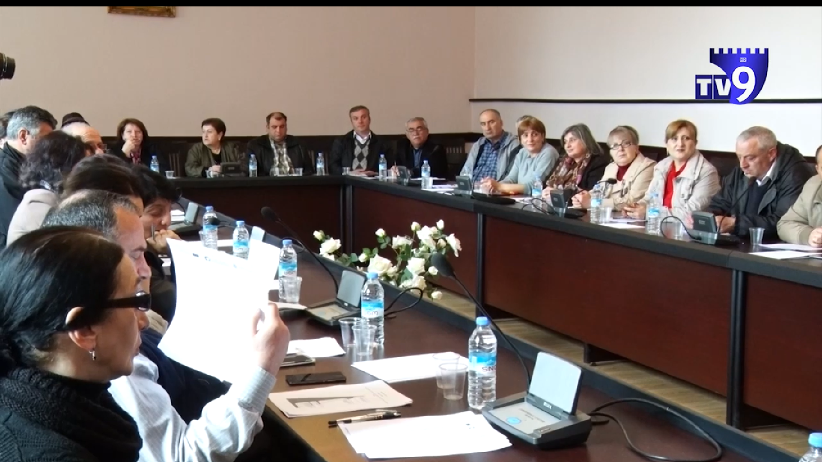
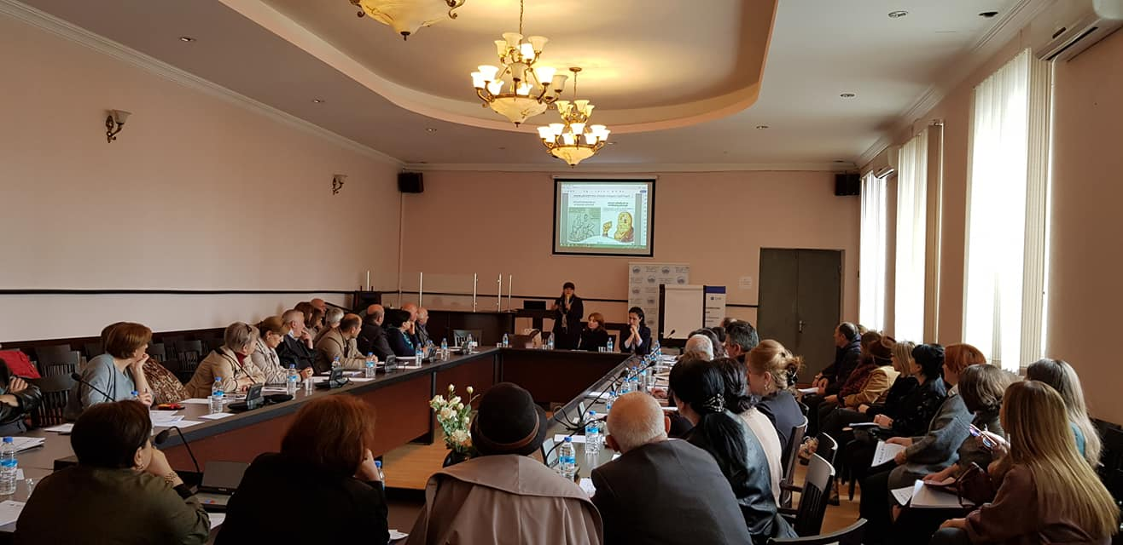
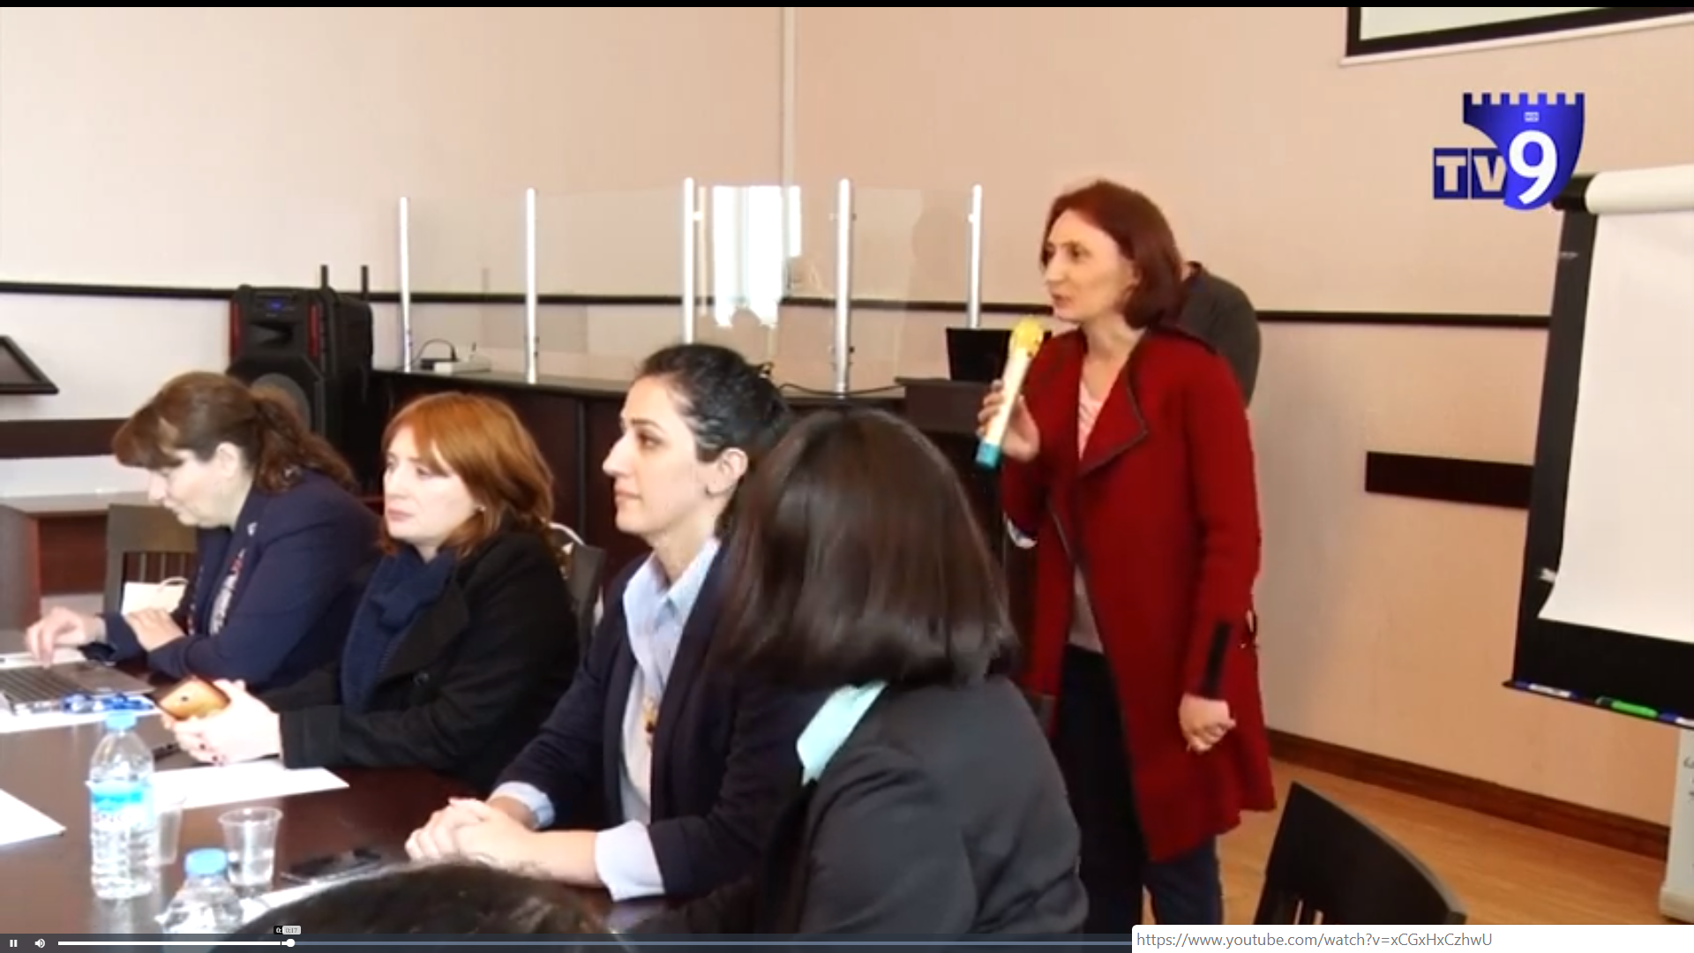
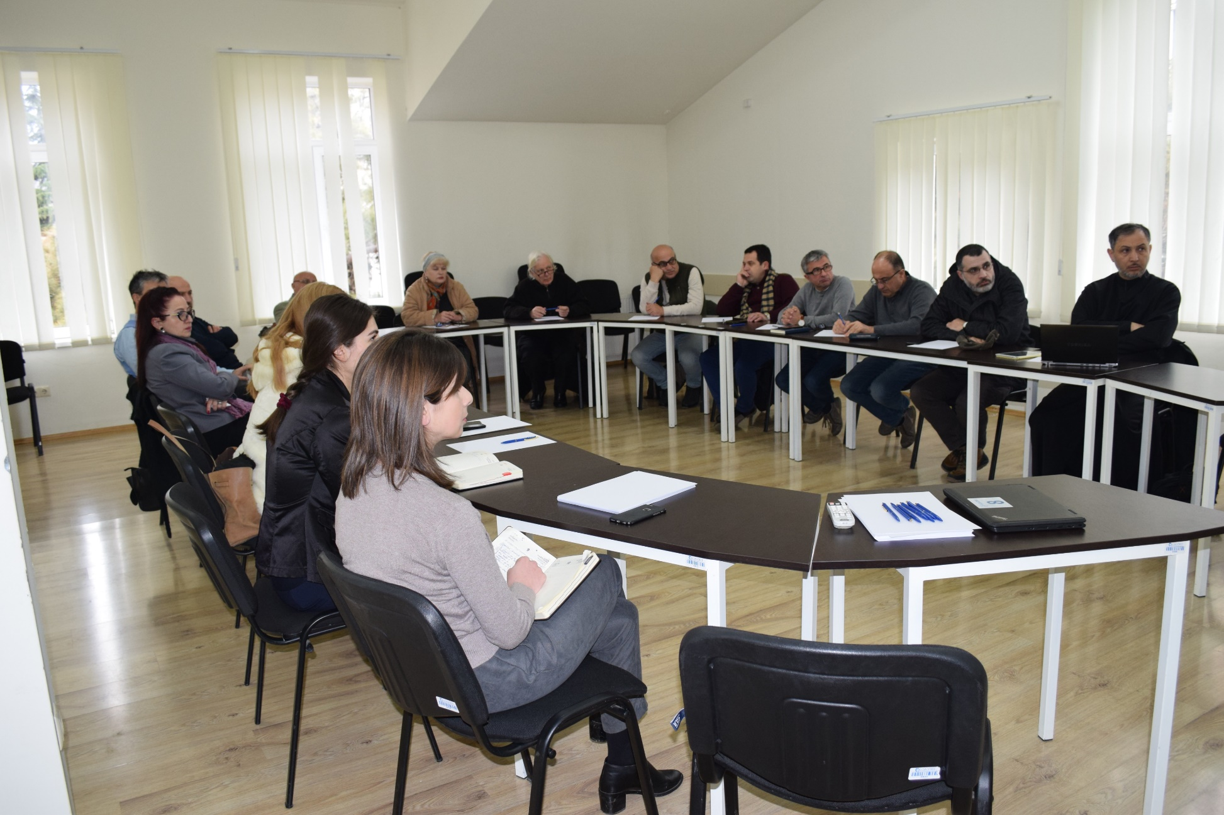
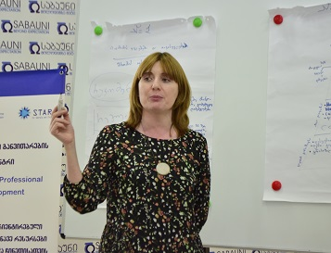
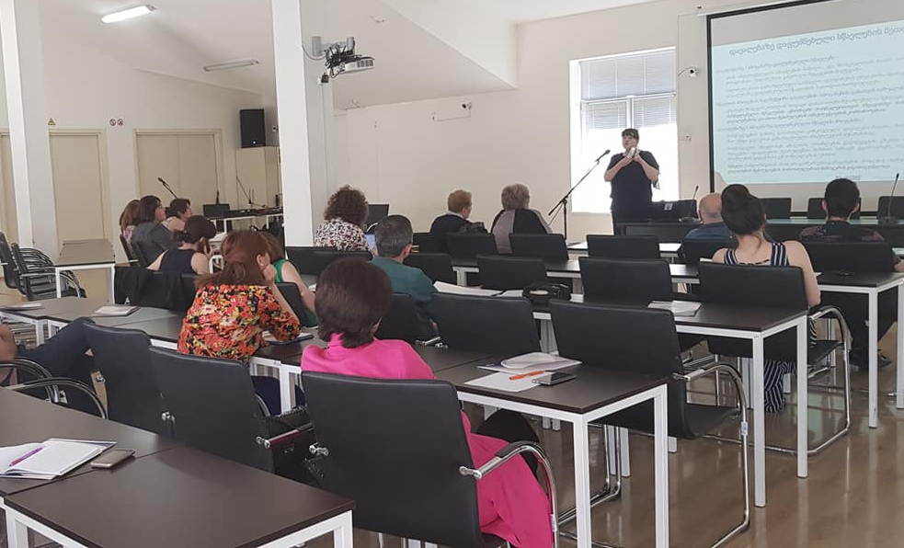
4. CPD Activities toward the Implementation of LCT Approach in HEIs
Sulkhan-Saba Orbeliani University

Slide 10
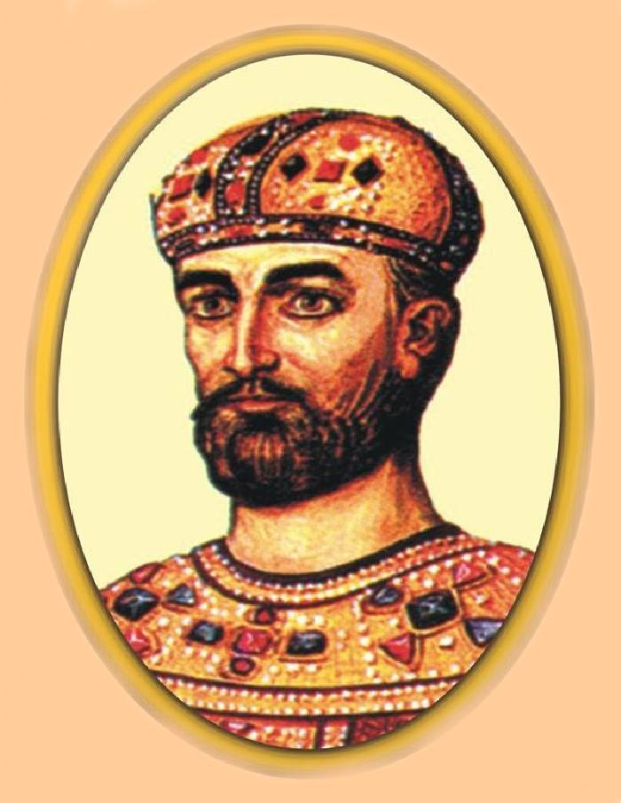
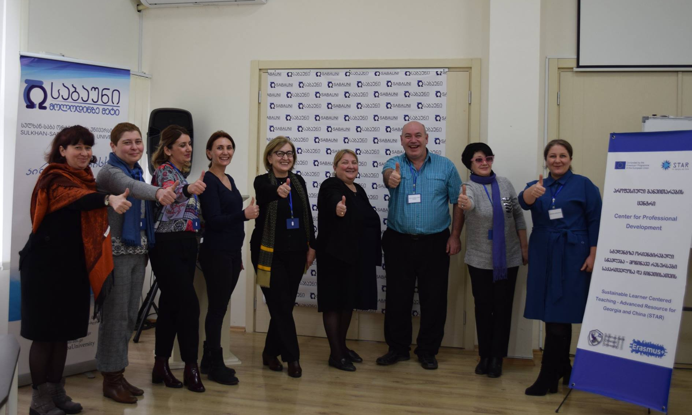
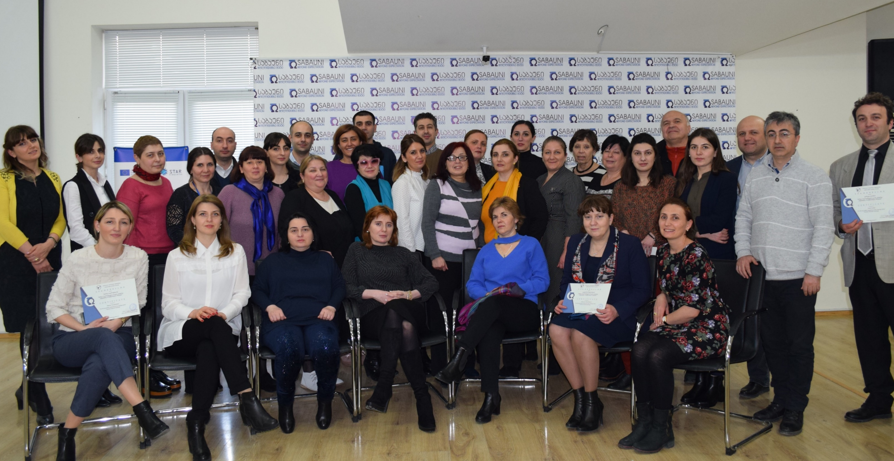
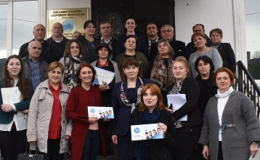
CPD Activities toward the Implementation of LCT Approach in HEIs
ILIA STATE UNIVERSITY
Samtskhe-Javakheti State University
HEI Education Academy
Totally were trained about
125 academic staff
from the following 12 Universities:
Georgian Universiy
SANGU
Sulkhan-Saba Orbeliani University
GEORGIAN TECHNICAL UNIVERSITY
THE UNIVERSITY OF GEORGIA
Tbilisi David Agmashenebeli
Teaching University
David Aghmashenebeli University of Georgia
Sulkhan-Saba Orbeliani University

Slide 11
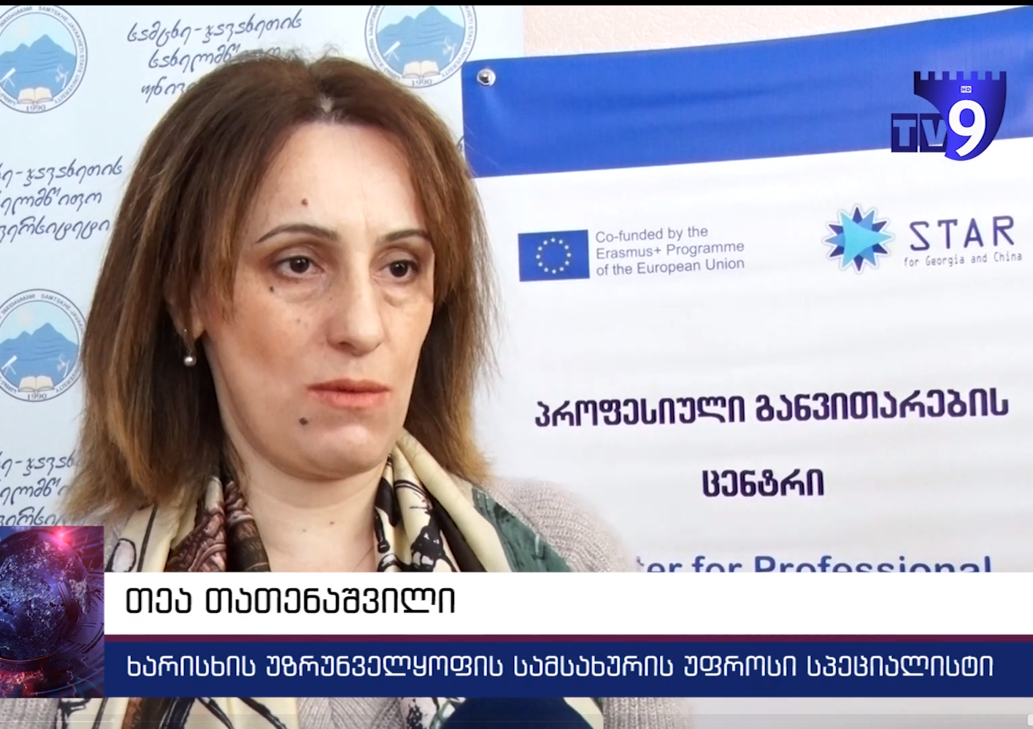
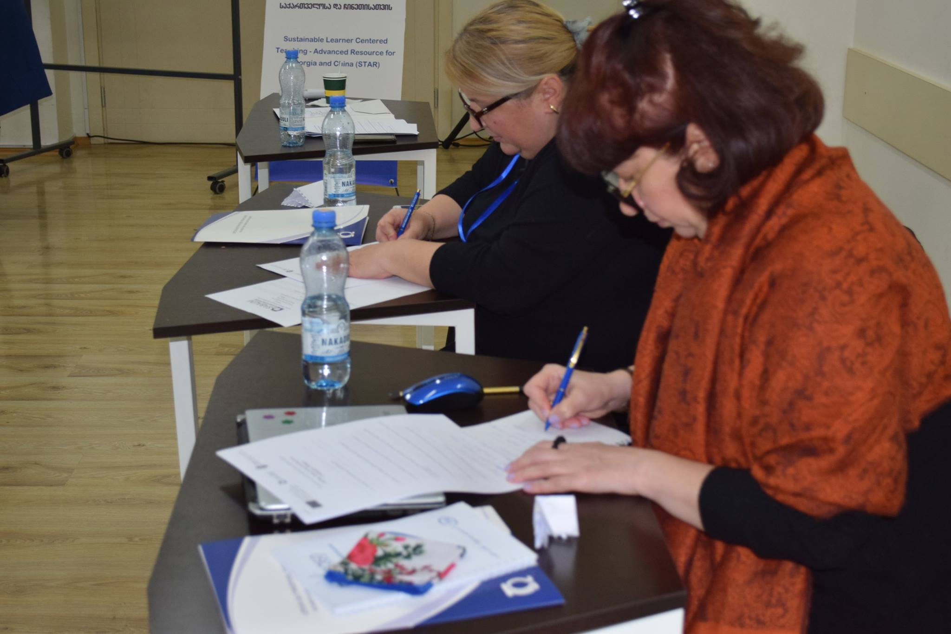
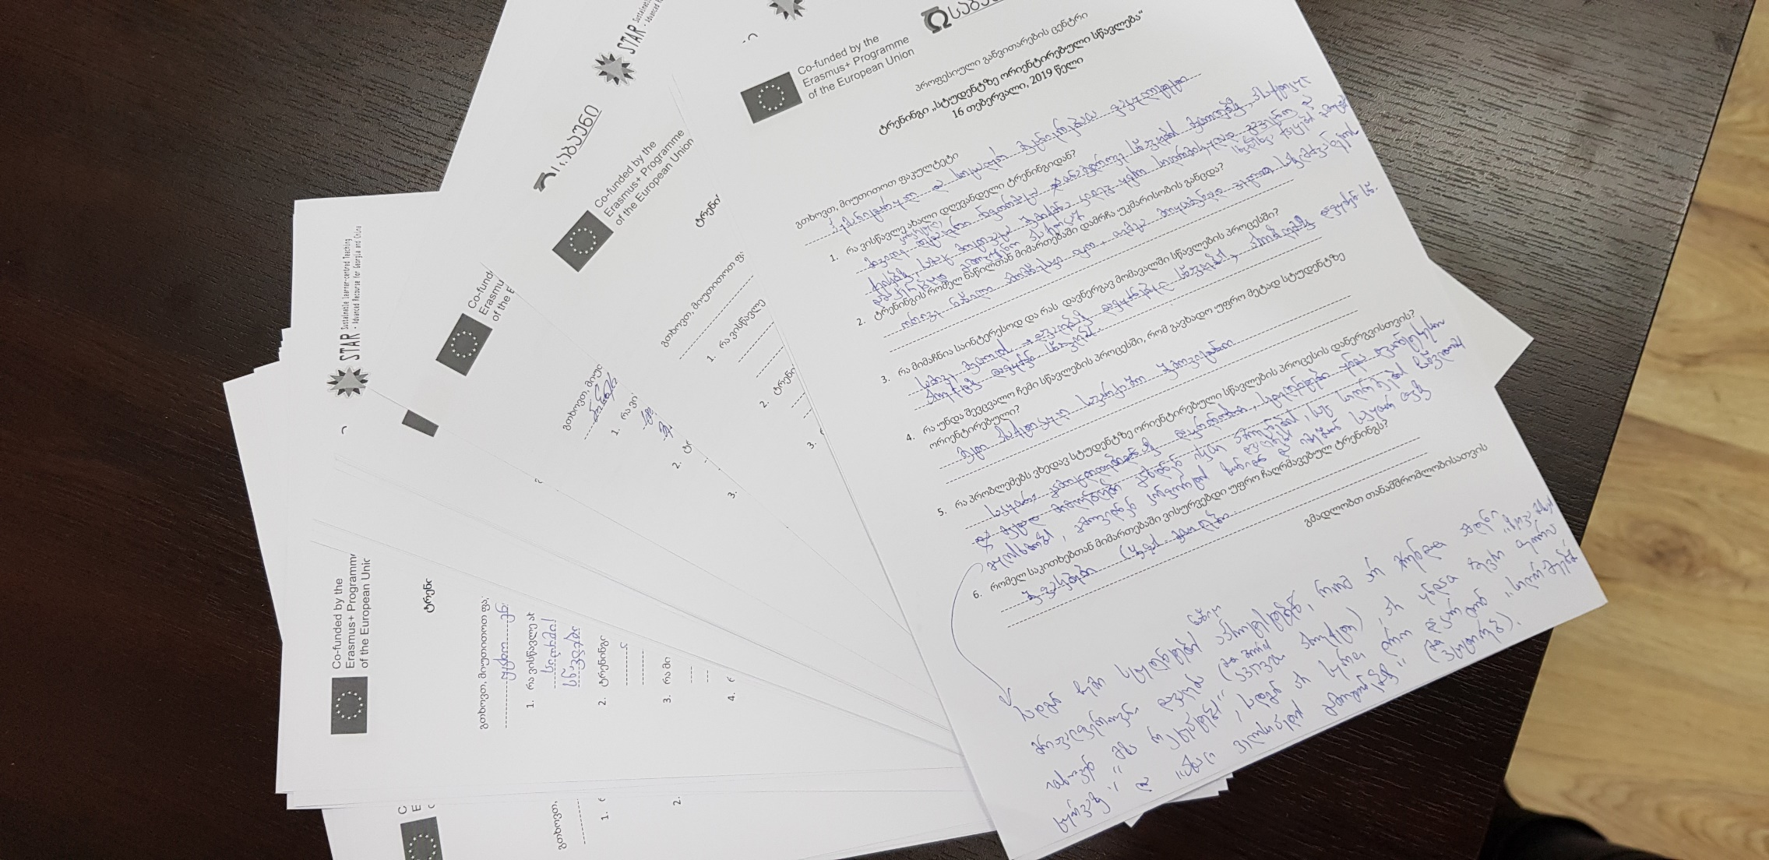
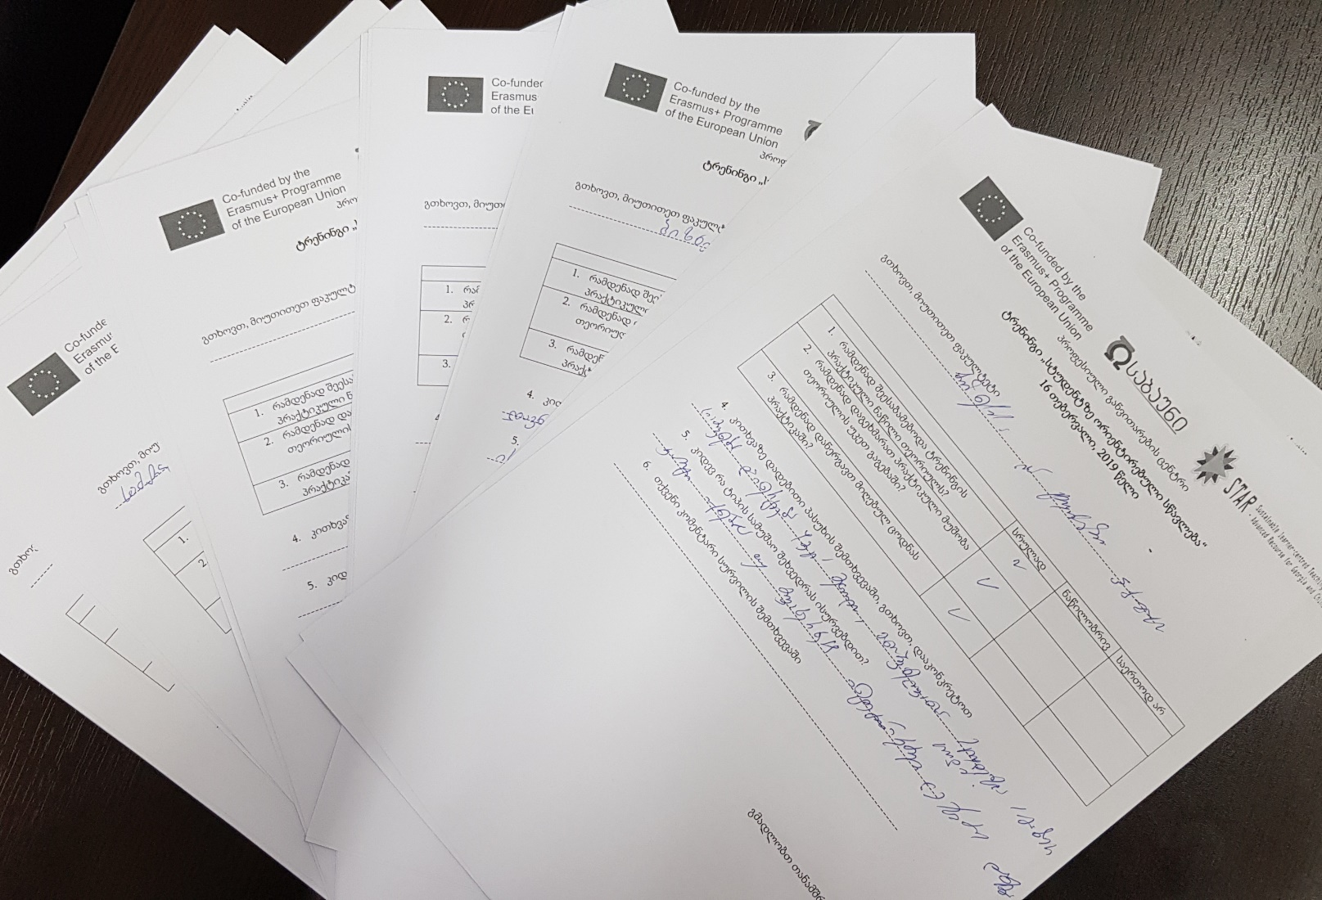
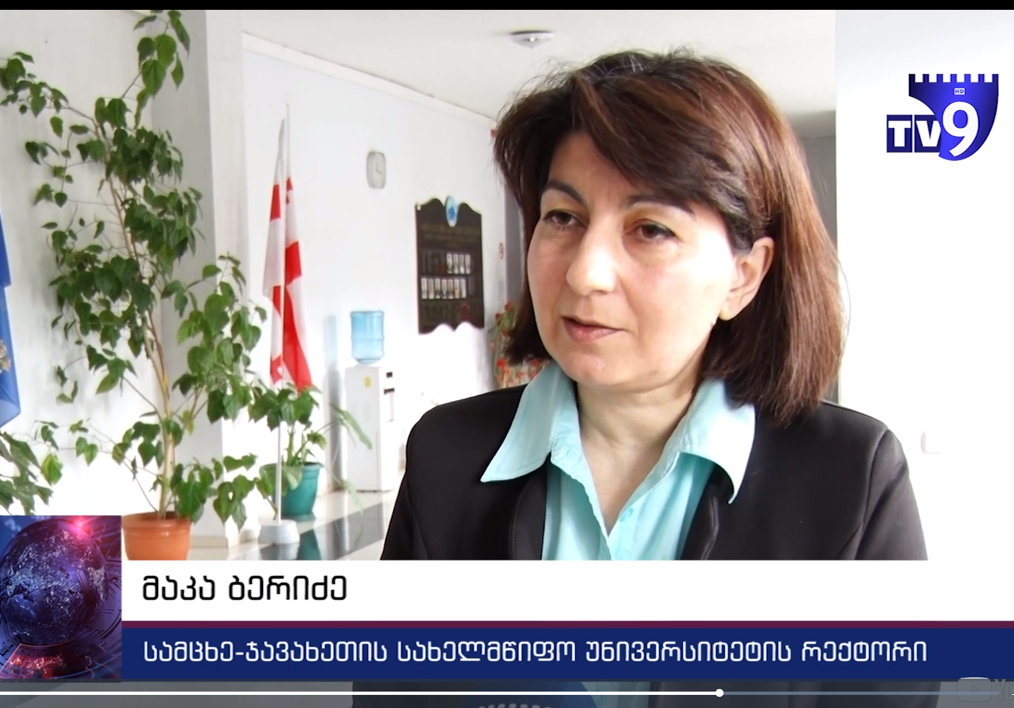
5. Assessments of the Trainings
Sulkhan-Saba Orbeliani University

Slide 12
Assessments of the Trainings:
Positive Feedbacks from Participants of HEIs
“ It was an honor to Academic Staff of our University to participate in Training organized by the trainers of the SABAUNI's CPD.
This Erasmus+ STAR Project training module has been created for teachers who want to learn more about managing an effective and up to date classroom that encourages participation and engaged learning using the latest techniques.
Trainers shared their knowledge and experience to help other participants deeply understand the essence of the LCT approach and achieve goals in applying of innovative teaching methods. Through interactive activities, participants learned how to promote a student-centred learning environment. “
Dr. Maka Beridze, Rector
LEPL Samtskhe-Javakheti State University
“ Participants not only have acquired more knowledge about student-centred approaches, but they also are able to take away ideas about practical, innovative solution to apply in their classrooms.
We believe that attending such training will significantly improve the quality of education in HEIs. It will help HEIs to develop the competencies of graduates by deploying a wide range of teaching strategies based on active learning. ”
Dr. Thea Tatenashvili, Senior Specialist of QA Office
LEPL Samtskhe-Javakheti State University
Sulkhan-Saba Orbeliani University

Slide 13
1. What was new for me from the training?
I got more information about the LCT methods
I received more information about the differences and similarities between some methods (PBL and TBL)
I learnt what kind of benchmark is priority during the PBL
The comparative analyzes between the new approaches, with interesting examples
2. What is more interesting for you and what kind of methods will you use in your practice?
I will use the scaffolding approach more intensively in my practice
I will spend more time in usage practical exercises
PBL and TBL
Discovery learning
It would be interesting to use PBL in the groups, as I use it in individual teaching
I will pay more attention on PBL
I will use all the gained knowledge in my practice in order to improve the quality
3. What I have to change in my teaching in order to become it more learner centered
More practical exercises
More case study approaches
More usage of case study methods
Usage of more Combined approaches in the practice
More cases from the daily life as an examples
I have to be more passive and student have to become more active in the teaching process.
4. In my opinion, what is the main challenge to implement LCT in teaching process
less motivation of the students to learn something new, to be involved in the teaching process more actively;
To move from traditional methods to the LCT
It is very hardworking for the professor to prepare materials and conduct the class wit LCT
5. What kind of training/workshop would you like to attend in the future
About assessment
Discovery learning (especially for the PhD teaching)
Learning contract
More information in Case study
The learning outcomes and the ways how to reach these outcomes
How to push the student to be involved in the teaching process and increase their motivation
Assessments of the Trainings:
Positive Feedbacks from SABAUNI Participants
Sulkhan-Saba Orbeliani University

Slide 14
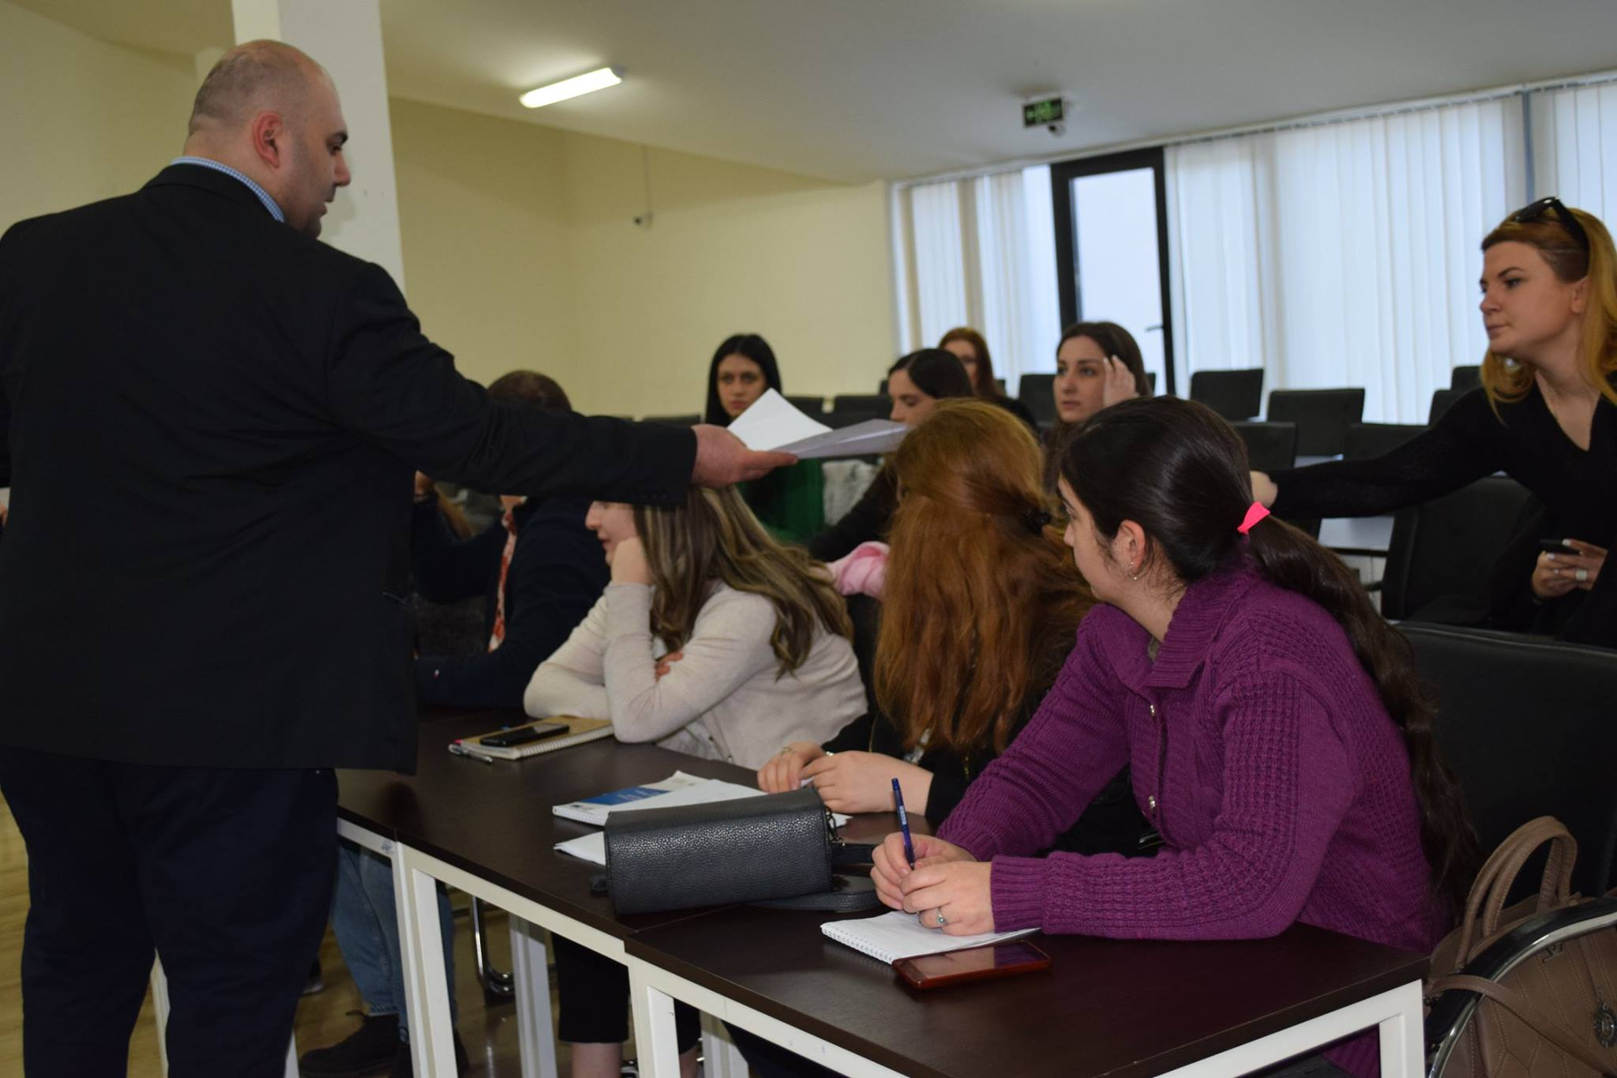
Assessments of the Trainings: Positive Feedback from Students
Interviews show that practical implementation of LCT methods lead to:
Increased student engagement with the content
Deep learning
Long term retention
Acquisition of critical thinking or creative problem-solving skills
Positive attitude toward the subject being taught
Confidence in knowledge or skills
Teaching process changed and learning became more:
Interactive: Students solve problems, answer questions, formulate questions of their own, discuss, explain, debate, or brainstorm during class
Cooperative: Students work in teams on problems and projects under conditions that assure both positive interdependence and individual accountability
Inductive teaching and learning: Students are first presented with challenges (questions or problems) and learn the course material in the context of addressing the challenges.
https://drive.google.com/file/d/1GXeBfdV9AFd4Izfsz3gL4O3mSYjNc_k7/view?fbclid=IwAR2l34sL_Jo_e1erJyBMJXg25jnVty-r2tjxtwYlrOYfc9oX6v3Qy-dbGlM
Sulkhan-Saba Orbeliani University

Slide 15
Assessments of the Trainings: Positive Feedback from the QA Office
At the beginning of the Academic Year - Period before trainings
Direct instruction focuses on
Passive/in some cases Active methods in Syllabi
Effective direct instruction / whole class teaching
A lack of knowledge in lesson planning
Questioning skills and testing
Classroom management
Students were less motivated
Most the students get an average grades
Minimum Standards for LCE
are achieved
The end of the Academic Year-
Post- training period
Learner-centred approach focuses on
Active and Interactive methods In most of Syllabi
Effective interactive teaching
Lesson Planning and preparation
Assessment of competencies
Critical thinking & team working
Students are more motivated
Students get higher grades
Criteria | Can be met through Direct Instruction?
Lessons are engaging, students motivated | ✓
Atmosphere of mutual respect | ✓
Learning builds on existing knowledge | ✓
Dialogue in teaching and learning | ✓
Relevant curriculum | ✓
Skills and attitude outcomes as well as content – skills include critical and creative thinking | ✓
Assessment tests skills, allows for individual differences, not purely content-driven or based on rote learning | ✓
TBL-
https://bit.ly/2WGWaBc
Sulkhan-Saba Orbeliani University

Slide 16
Challenges
Teachers’ challenges
Still need to maintain quality and set high expectations
Still need teaching plan and need to stick to it. But need to be flexible and allow some “wiggle room”
Need to prepare students for the new active model
Take a long time for teachers so that teachers in general do not want to use cooperative learning
It requires special skills of teachers so that not all teachers can do or use of cooperative learning
Institutional challenges
Academic reward structure
Academic rules for hiring and promotion
The infrastructure
The diluted mission of the university
The institutional culture
Financial considerations
Expectations of changes direct teaching to the Innovative learning approach and results of LCT implementation are too high, but the speed of expected change is too rapid.
difficulties joined-up change of:
curriculum
infrastructure
teacher education
examination
assessment systems.
Students’ challenges
Students should have control over their learning
Students have different experiences and background knowledge and interests
weaker students should be placed with more able students to act as scaffolding
LCT Increased student engagement with the content
Increased student learning and long-term retention
It requires a longer time and hard work for students to develop competencies, so it is difficult to achieve curriculum targets
Reasons for not using LCT- approaches
Lack of confidence in using a range of methodologies
Waste of Time
The exam system - standardized tests
Class sizes and contact hours
Classroom layout, teaching materials
Student attitude and motivation
Perception of other teachers
Sulkhan-Saba Orbeliani University

Slide 17
Findings and recommendations
Practices need to be changed to achieve LCT
Principles underlying LCT
LCT requires an ongoing reflexive process
LCT does not have a “One-Size-Fits-All” solution
students have different learning styles
students have different needs and interests
students have different experiences and background knowledge
students should have control over their learning
LCT is about “Enabling” not “Telling”
learning requires cooperation between students and staff
Right choice of methods, strategies and activities and is central to effective learning.
The functions of content
The role of the teacher
The responsibility for learning
The processes and purposes of evaluation
The balance of power
Sulkhan-Saba Orbeliani University

Slide 18
Benefits of Learner-centred Teaching
Institutional benefits of LCT
Quality enhancement
Higher student retention rates
Recruitment: attractiveness for students
Creates other opportunities (adult education)
Increased credibility in relation with employers
Potential positive differentiation against other universities
Students’ benefits of LCT
Students can adapt the way they learn, to make their studies more effective.
Students discover that learning is interesting and fun.
Helps students transfer skills to the real world.
Students adapt learning to the real world, gaining problem-solving skills and ability to do a critical analysis of a given set of data.
These skills enable the student to adapt to a constantly changing real-world environment
Teachers’ benefits of LCT
Students understand the function of the content, why it is learned
Students develop learning skills for further learning;
Increased responsibility, accountability, autonomy
interdependence and mutual respect within teacher-learner relationship
Responsibility is shared between the teacher and the students;
Teachers have less traditional work to do
Assessment of competencies is possible during classes
Reports and papers generated by students increase a teacher's collection of useful information.
Sulkhan-Saba Orbeliani University

Slide 19
Planned Activities:
Needs Assessments and planning trainings for
The SABAUNI’s academic staff on different instructional methods can be used a Learning-centred Approach
Trainings for the new hiring academic staff with a lack of knowledge and practice in LCT
Public trainings on LCT for Academic Staff of HEIs, as well as external stakeholders
Elaborating modules, preparation for delivering on-line Training courses
Planning activities for the preparation and implementation of ISO 9001 Certificate
Planning Activities for the accreditation of CPD and Training Programs
Finding ways for participation in programs and projects supported development of CPD units.
Sulkhan-Saba Orbeliani University

Slide 20
გმადლობთ, ყურადღებისთვის!
Tak for din opmærksomhed!
Děkuji za pozornost!
Благодаря ви за вниманието!
Obrigado pela sua atenção!
谢谢你的关注！
Sulkhan-Saba Orbeliani University

