Slide 1
Shota Meskhia Zugdidi State Teaching University
Established 2007. Situated at the administrative boarder of Abkhazia (occupied territory by Russia)
Special policy in the region (implementing variety of professional educational programmes, Bachelor and Master degree programmes)
Only one state HEI in the region (west part of Georgia)
Center of excellence and innovation
Hosting IDPs students and involved in several state projects for IDPs (implementing preparation courses and so…)

Slide 2
How do we started?
Learner Centered, Students Oriented _ there were something new. The idea that something has changed, something was wrong and must be turned to the right. What was current situation:
Passive students
Lectors like authorities and authoritarianism at the same time
Time management
Methods
New competencies
State requirements

Slide 3
What Was Missing?
Georgia joined Bologna process from 2005 and the process really started but it was hard and at the same time great process of changes in each level, innovation, modernization, authorization and programme accreditation, teaching methodologies, meetings and trainings, seminars and all of us where looking for everything new BUT
Systematic approach
Skilled staff
Proper understanding of students oriented
New policy for HEI
No links between HEIs and secondary schools and employers

Slide 4
Lifelong Learning Centre (LLL) – STAR - CPD
Hard period of changes
Checking existing situation (where we are? What we are doing? How we are doing? What can be and can not be changed?)
Raising awareness of involved parties
Define needs and identifying problems
Assess the situation
Organizing meetings with students, staff (academic and administrative), faculties

Slide 5
What was achieved?
New international projects with the results _
Internationalization _ PICASA
Career development _ CASEDE
Students support services _ DARE
Academic integrity _ INTEGRITY
Mobility abroad for staff and students and the
Readiness for new and new challenges
STAR _ the best of all with the goals and ideas how to start from turning to the learner center/students oriented to the best practices, tools, re trained staff, real steps, real results, increased hours, students and staff workload, from lectures for lecture to the group works for students, multicomponent assessment system, lectures with new skills

Slide 6
What was achieved?
Changes in management
FLLC _ foreign Language Learning Center
CC _ Career Center
SSS _ Students Support Service Center
CPD _ Continues Professional Development
New young staff
Alumni involved in management and student services

Slide 7
CPD unit is a structural unit under the Lifelong Learning Centre.
Creating working group responsible for fulfillment of all necessary project activities.
CPD Unit focuses and infrastructure
CPD Unit focuses on academic staff, educational programme development (modification), trainings, support services for school teachers.
CPD unit has its laboratory and the equipment purchased within the project is available here.

Slide 10
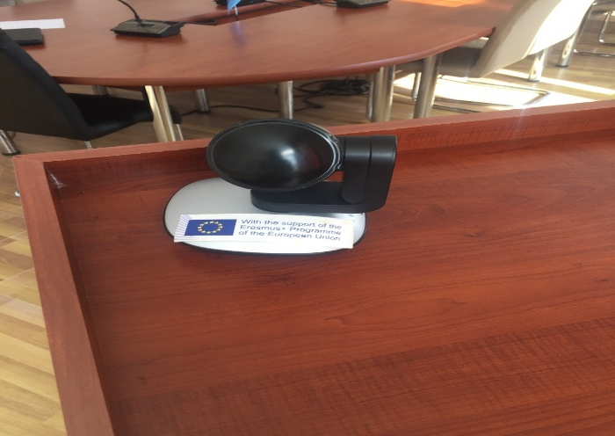
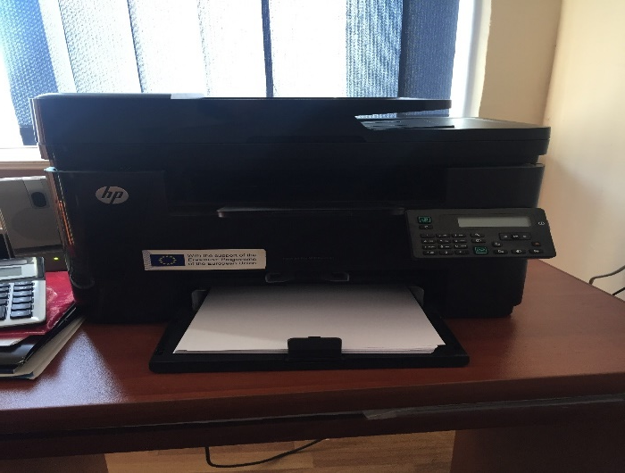
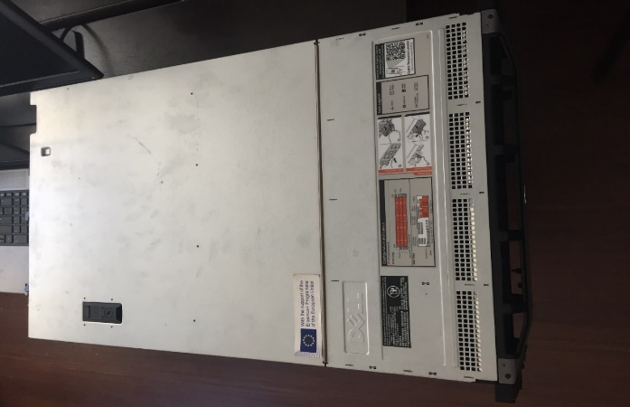

Slide 11
Spreading the information on the web page of the university and social media

Slide 13
Useful links from the university web site
http://www.zssu.ge/zssu2/node/2056
http://www.zssu.ge/zssu2/en/node/2057
http://www.zssu.ge/zssu2/en/node/2053
http://www.zssu.ge/zssu2/node/2052
http://www.zssu.ge/zssu2/en/node/1899
http://www.zssu.ge/zssu2/node/1898

Slide 15
Participation in online trainings for the academic and administrative staff using Moodle platform, widely used MOODLE platform
Modification of syllabuses
New methodologies and changes on the state level
Qualification framework with description of competencies
Self assessment
Planning lectures
Rubrics

Slide 16
Thank you for your attention
ZSSU
mosiabela@gmail.com 3/06/2019

