Slide 1
What STAR Has Brought to Us and the Future Challenges We Face
--- LNU Team

Slide 2
1
Introduction
CONTENTS
2
Achievements
3
Influences
4
Challenges

Slide 3
Introduction
In the era of information explosion, it becomes more important to master the methods of acquiring knowledge than knowledge itself.
How to cultivate students' core literacy in the 21st century has gradually become the most important problem in different countries around the world.
"learner-centred teaching", whose educational idea means to meet the development needs of students and to cultivate the talents for social development has great significance of cultivating innovative talents for higher education nowadays.

Slide 4
Introduction
The idea of promoting LCT as a means of increasing the responsibility and autonomy of learners was well recognized by Chinese government, that’s the reason why the change of paradigm in the higher education systems in China from teacher-centred to student-centred teaching began from 2000.
Several key conferences in the Ministry of Education of China should be mentioned because they made great efforts to the spread of LCT.

Slide 5
Key conferences
1
2
3
In August of 1994, it is the first time to mention quality education in the document of National Conference on Education. That means China began to change the examination-oriented education system to quality-oriented education system.
Mr Chen Baosheng, Minister of Education, mentioned "learner-centered" twice in his report on the work of the 2017 National Conference on Education. It means the government promotes LCT in the big data period.
In February 2007, "Some Opinions on Further Deepening Undergraduate Teaching Reform and Improving Teaching Quality in an All-round Way" was issued by the Ministry of Education in China.

Slide 6
Although the Ministry of Education of China has advocated LCT for almost 15 years, there are 2879 universities and colleges in China, with different teachers whose knowledge and comprehensive abilities are distinct, maybe leading to misunderstanding of LCT in specific teaching activities and teaching designs.
Therefore, the STAR project provides us a good opportunity to disseminate the LCT among teachers, and train them to use LCT methods in their classes in order to make teaching more effective.

Slide 7
Achievements
点击添加文本
Disseminating
the ideas of “Learner-centered” teaching
Building
CPD Units
Building
CPD Units
Building
CPD Unit
Applying
“Learner-centered”
teaching in class
点击添加文本
点击添加文本
点击添加文本

Slide 8
1. Building CPD Unit
With the support of STAR and LNU, we cooperated with the academic affairs department in LNU and built the CPD Unit.
A trail training on LCT was given to 8 teachers in School of Foreign Studies after the Interim Conference held in Zhanjiang in last semester.
According to our training plan, this semester we have trained teachers in School of Foreign studies, teachers in the College English Department who are responsible for non-English majors, and Senior students who are future higher school English teachers based on the STAR Project Manual. The main contents of the training are LCT theory, LCT methods, teaching plan design, and classroom management in LCT classes. Totally we trained more than 250 teachers and students.

Slide 9
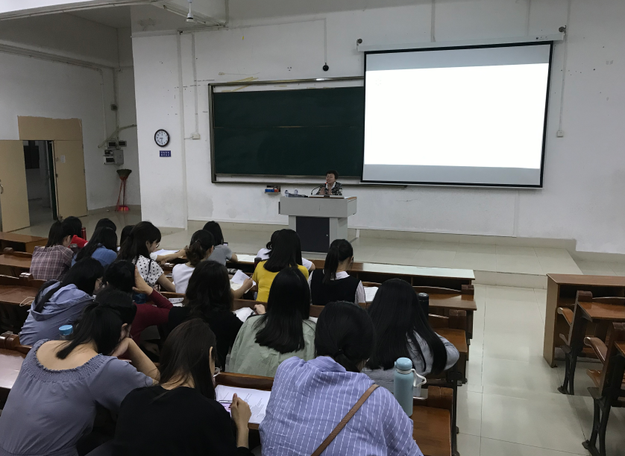
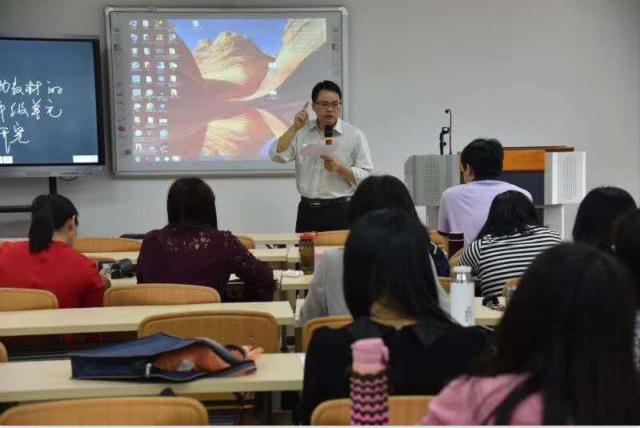

Slide 10
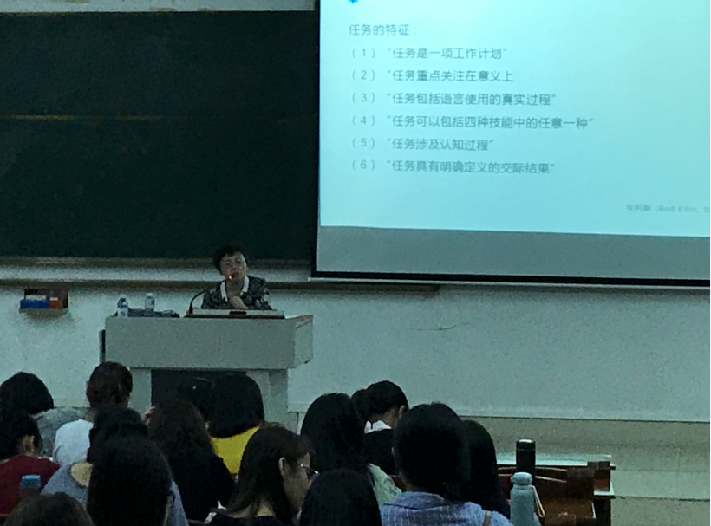

Slide 11
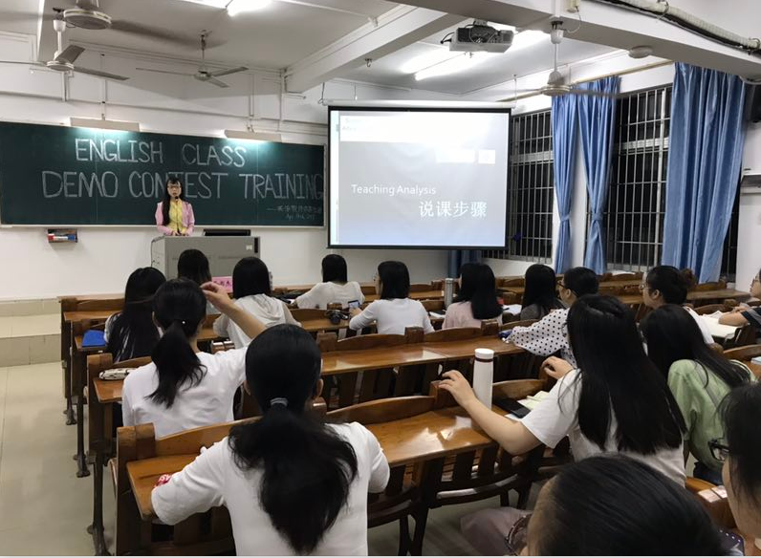
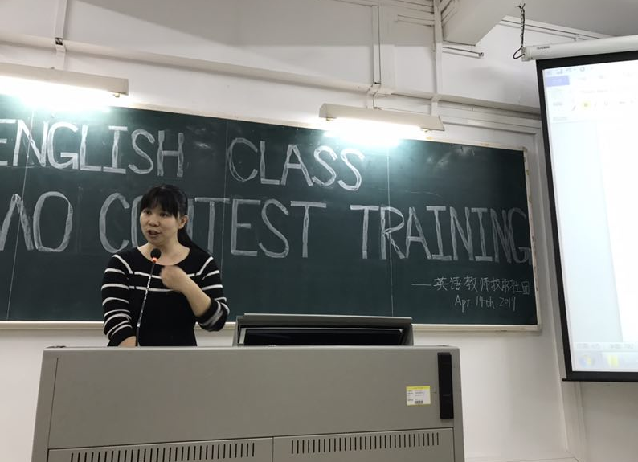

Slide 12
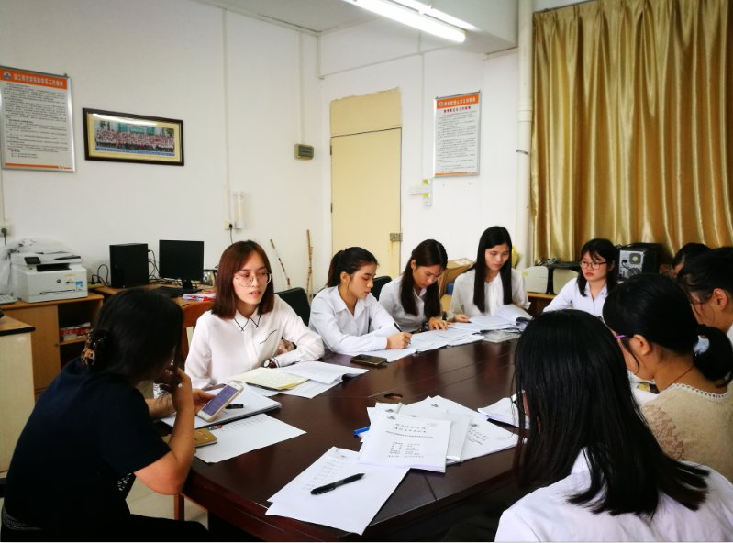
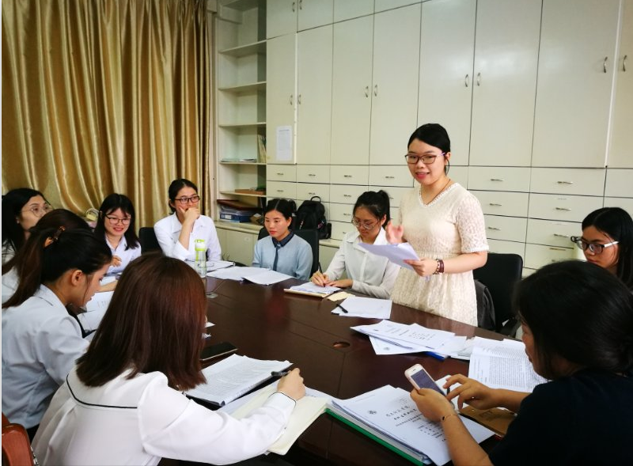
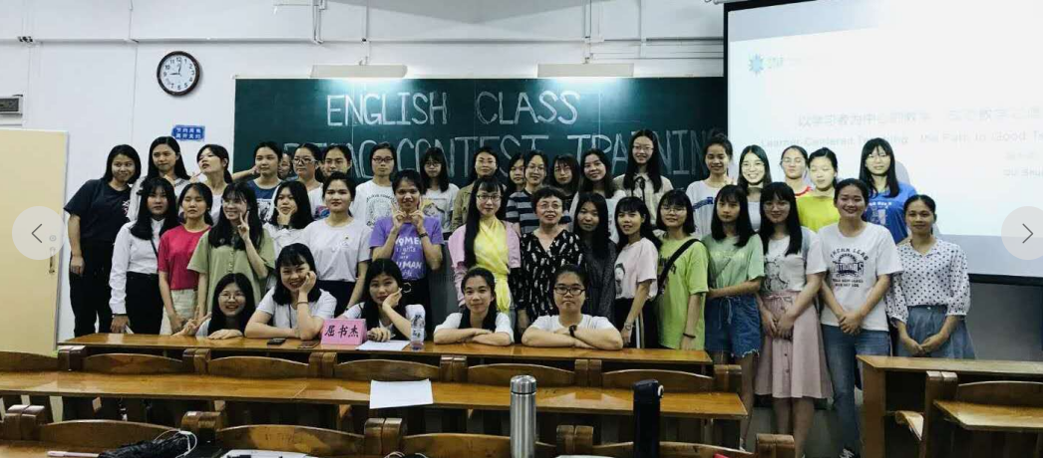
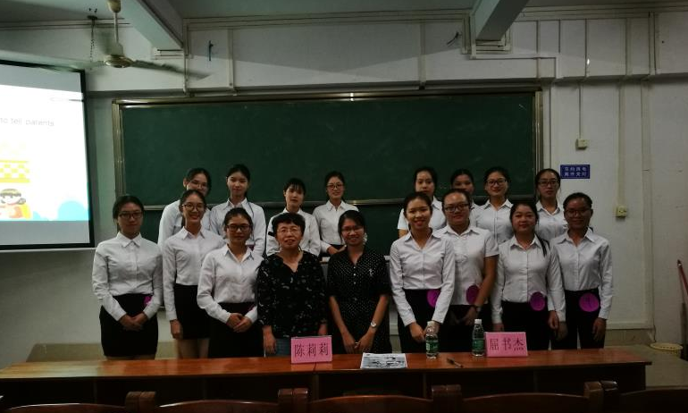

Slide 13
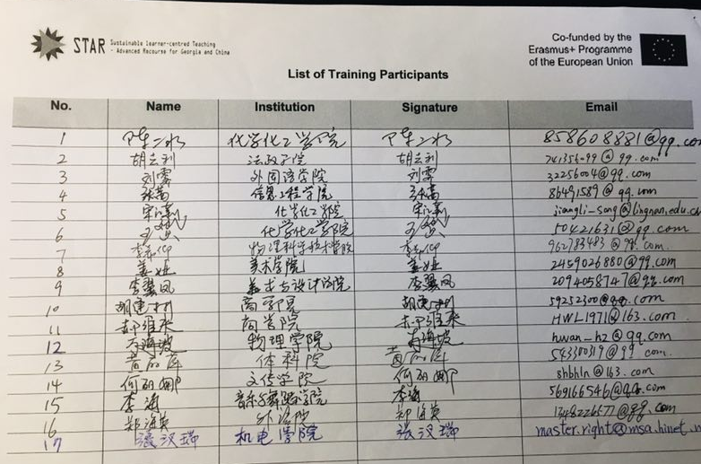
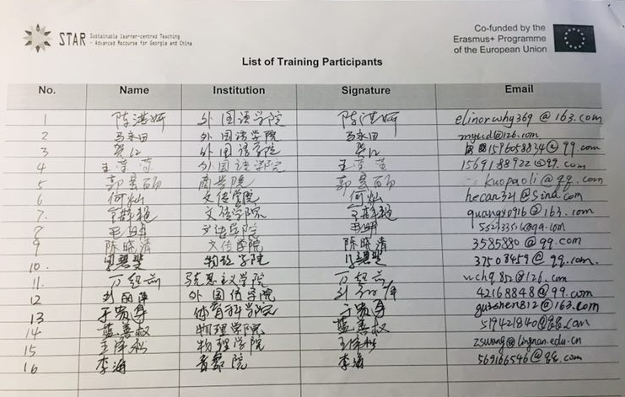
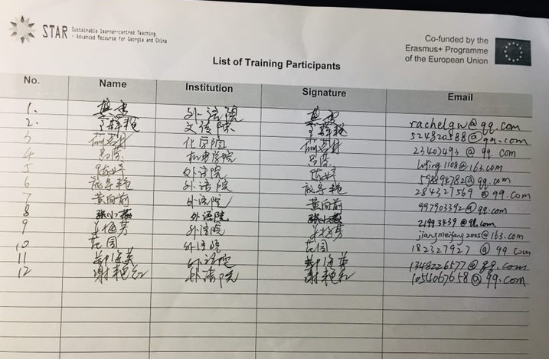
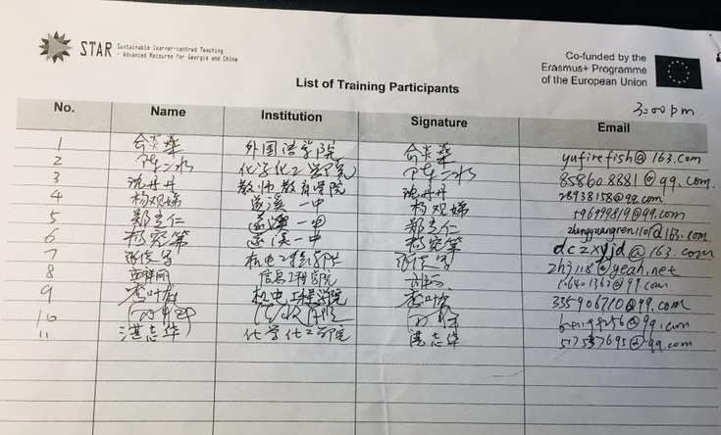

Slide 14
2. Disseminating the ideas of LCT
The members of LNU team not only disseminate LCT on campus, but also disseminate our STAR project and LCT to other universities when they attend some academic conferences at home and abroad.

Slide 16
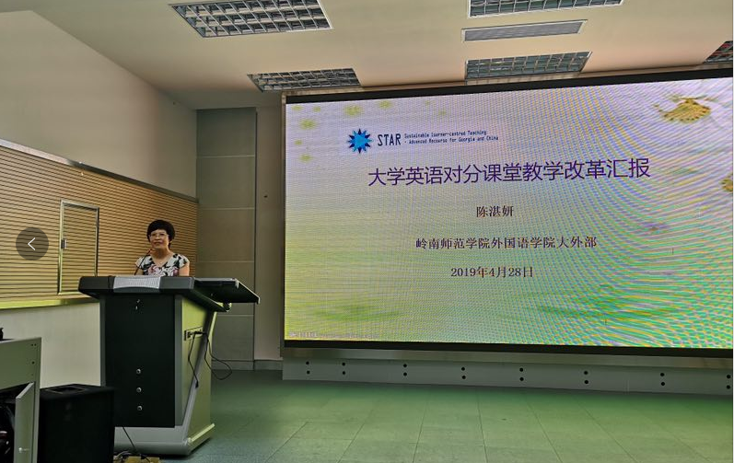

Slide 17
3. Applying “Learner-centered” teaching in class
After the team members in LNU had different trainings for the project of STAR, they have been recognized and welcomed by the students via applying LCT methods to the students in class.

Slide 18
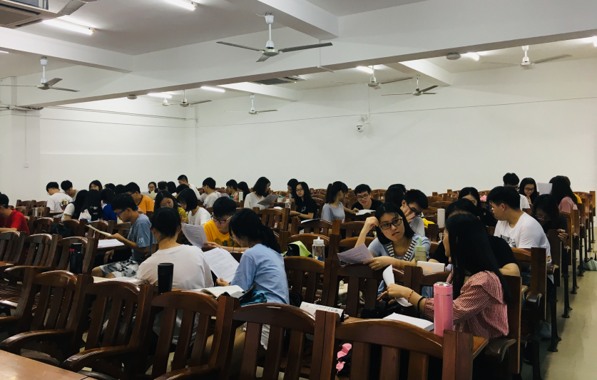
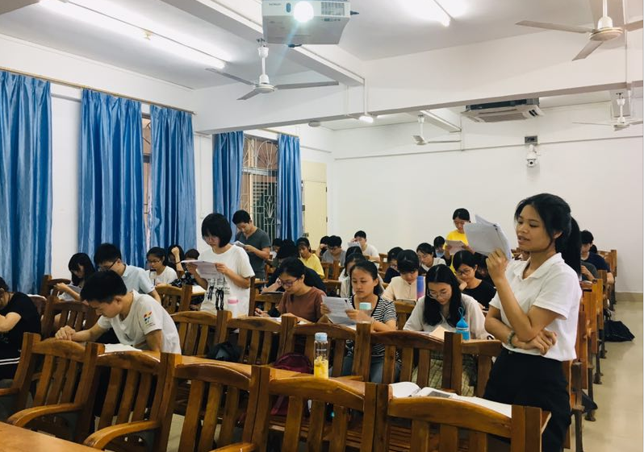

Slide 20
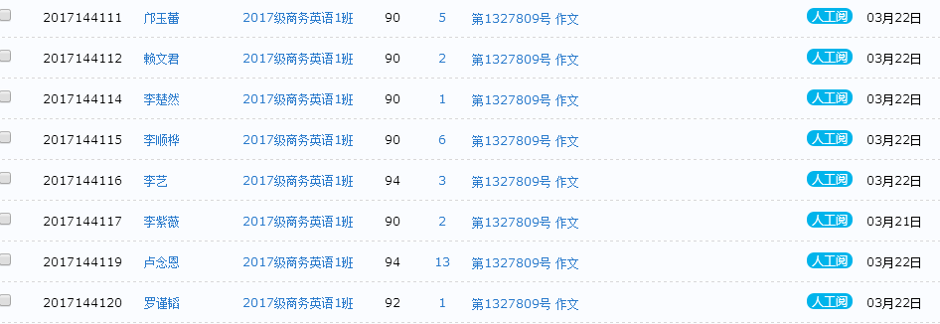

Slide 21
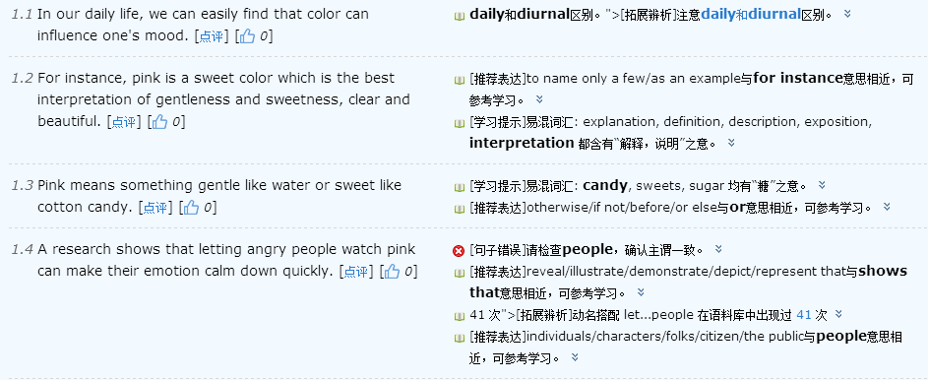

Slide 22
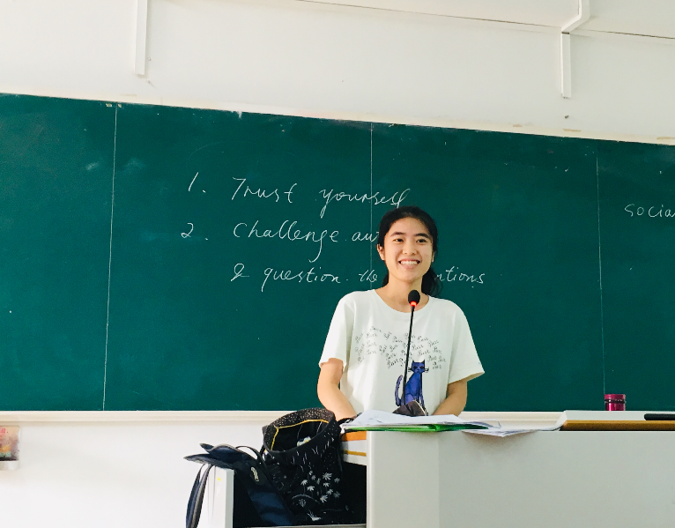
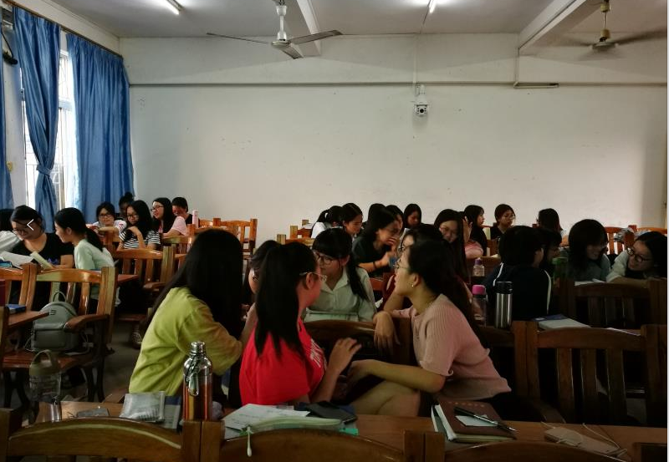

Slide 23
Influences
When the LCT concept is accepted by the university leaders and common teachers, the teachers in LNU are more active and enthusiastic in teaching, which has a great impact on our teaching.

Slide 24
Influences
Seminars on the Application of LCT
Teaching Contests System

Slide 25
Seminars on the Application of LCT in class
Every semester, there are two seminars on the application of LCT methods. Teachers who apply these teaching methods reflect on the teaching design of the curriculum, the development of classroom activities or tasks, the challenges and difficulties encountered in their teaching.
They can learn from each other for some highlights of their classroom. Experts and professors give timely guidance to the problems in authentic teaching, and further help teachers understand how to better organize teaching activities to meet students' needs.

Slide 26
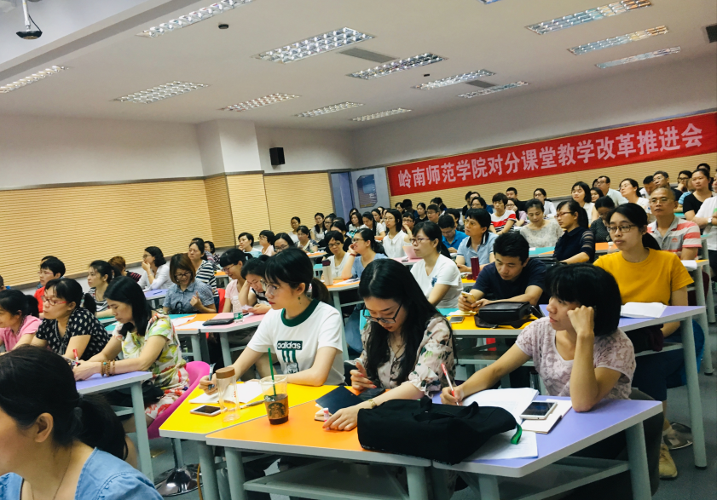
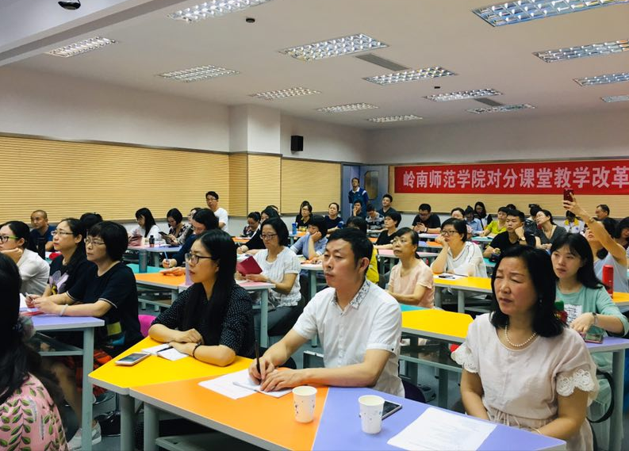

Slide 27
Teaching Contests System
In order to make more teachers understand and apply LCT methods in their class, LNU organizes an Annual Teaching Contest via LCT in two different levels---the school level and university level.
More and more teachers take part in contests and more and more teachers have better understanding of LCT. The winners of these contests can participate in provincial and national teaching contests.

Slide 28
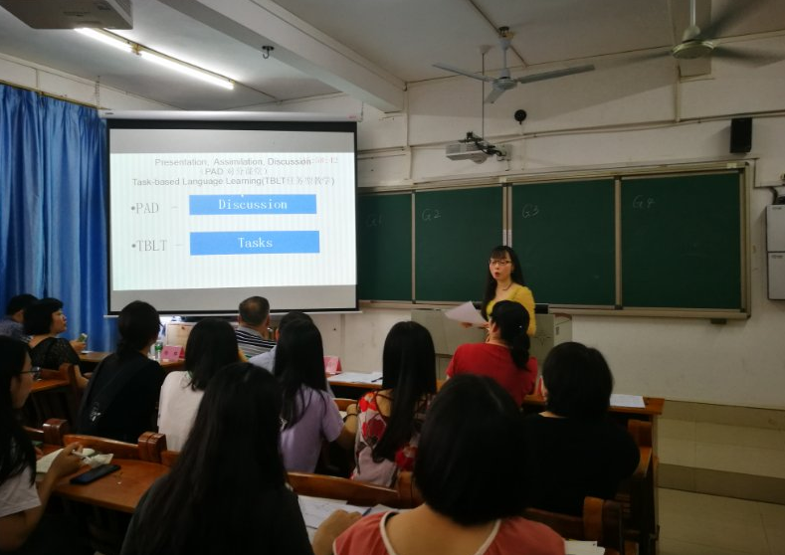
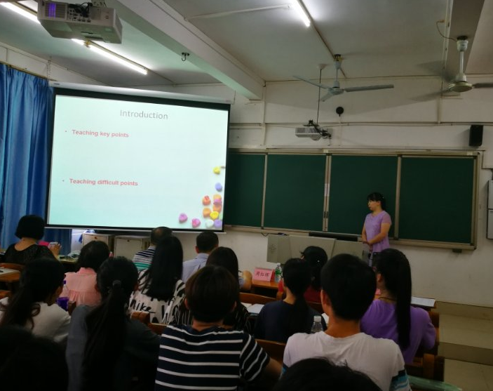

Slide 29
Challenges
In fact, there are some challenges in the last conference of the project and we are considering how should we face these challenges and how should we solves them.
1. Where to find teaching experts to train teachers using LCT methods after the project ? Where to find funds to support the future training?
2.How to involve more teachers to engage in LCT?
3. Any kind of teaching theory may be criticized. What should we do if some teachers can't see obvious effects in a short time in their class by applying teaching methods of LCT?

Slide 30
Agradecimentos！
THANKS
მადლობა！
FOR LISTENING
Děkovat！
您的聆听
благодаря！
30
Notes:
结束页

